Slide 1
3. Update of Parthenos Entities Model
And Now 1.11
Parthenos WP5 Update
ICS-FORTH –
15/03/2017

Slide 2
Services: New
E7 Activity
pp45 had competence
PE1 Service
PE36 Competency Type
PE2 Hosting Service
PE8 E-Service
PE3 Curating Service
PE33 E-Access Brokering Service
pp46 brokered access to

Slide 3
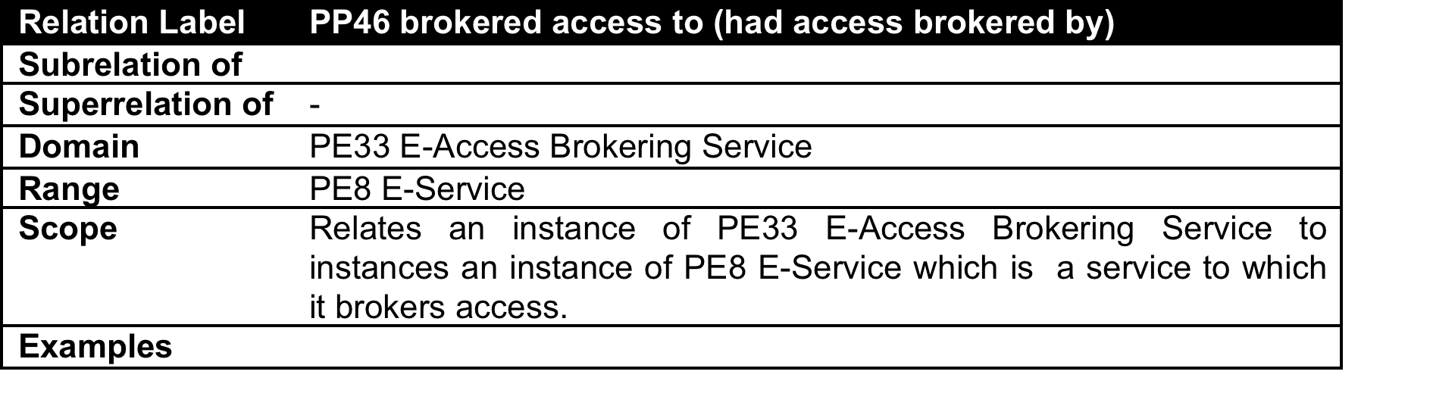
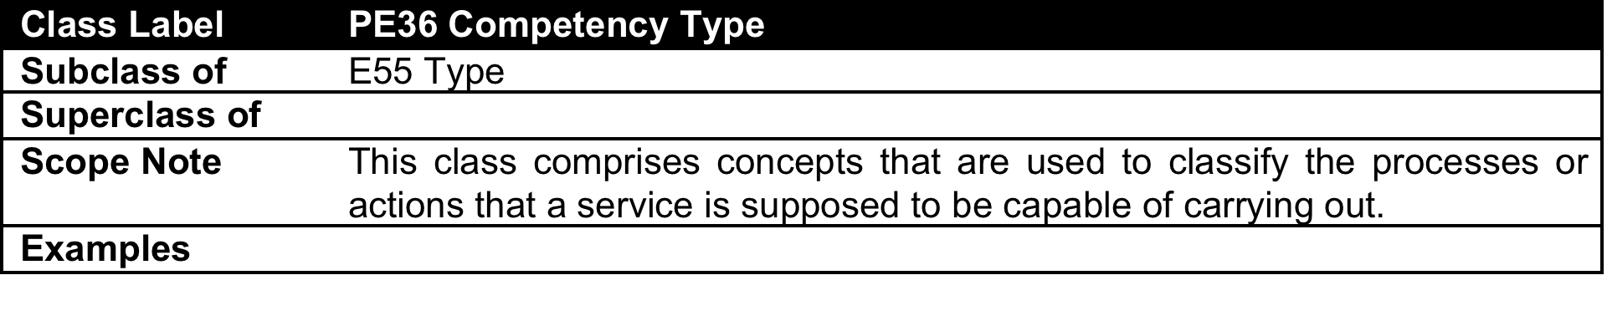
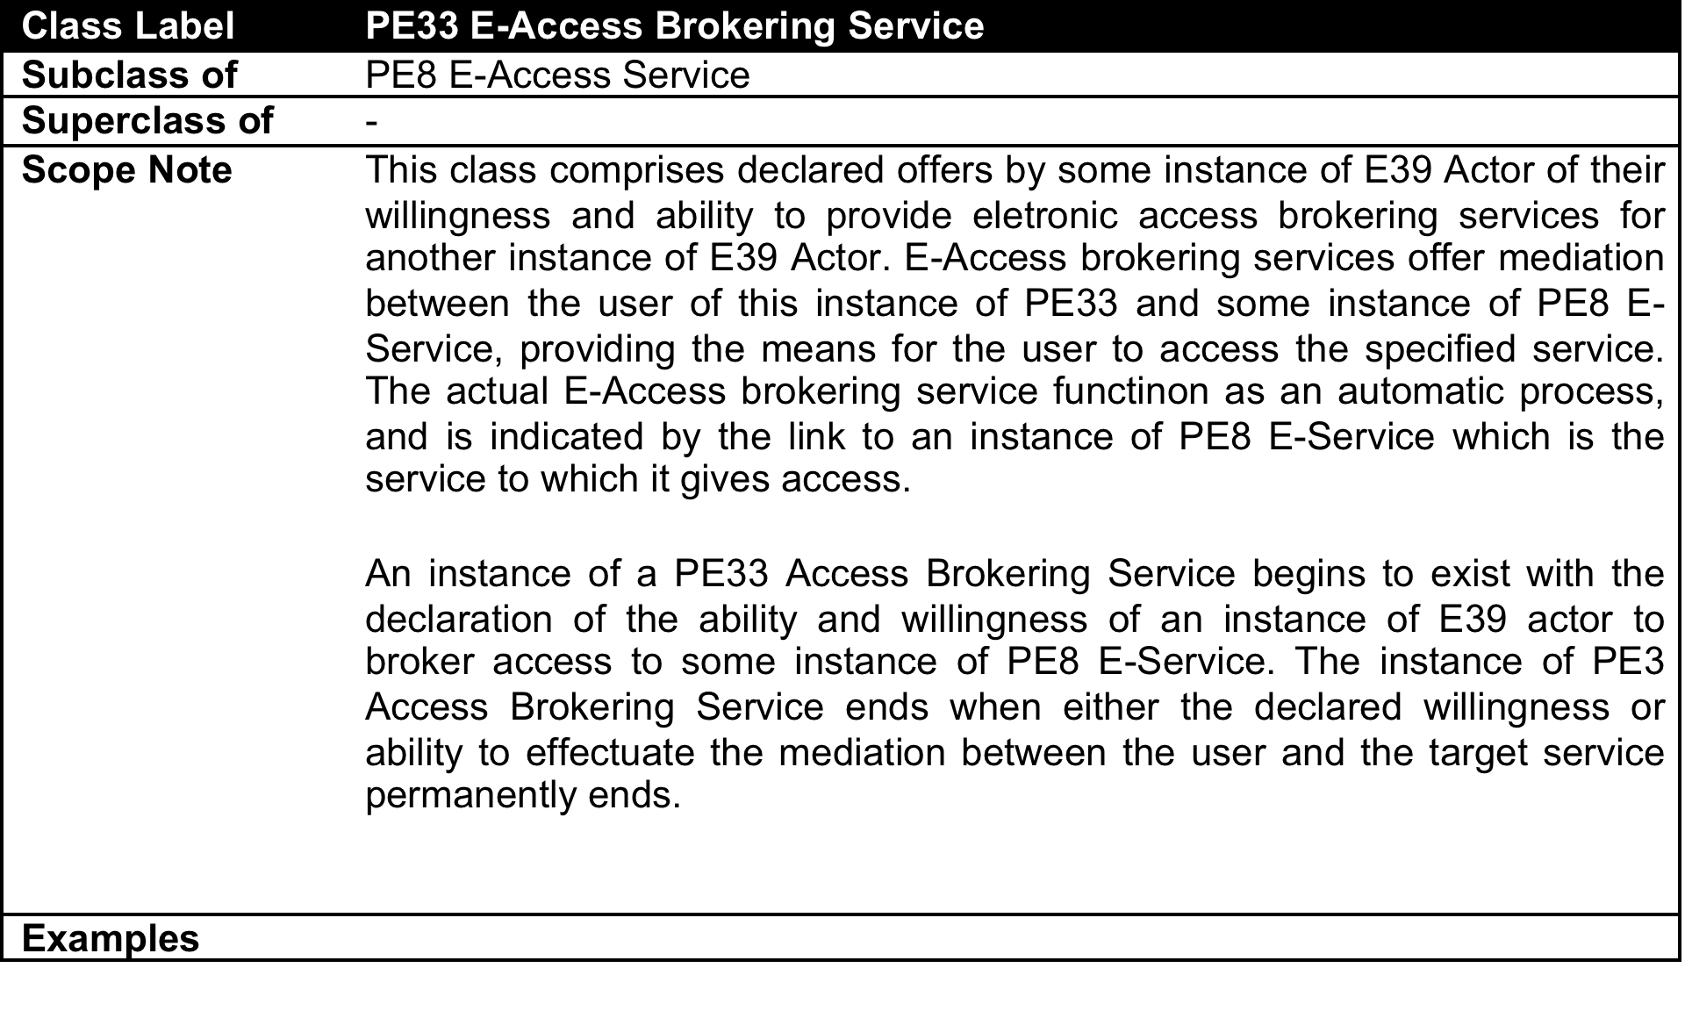
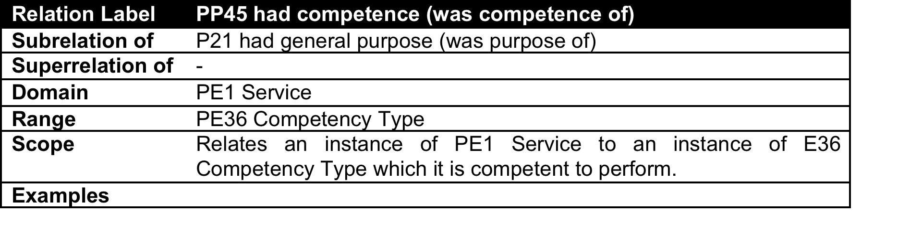
New Service Classes and Relations

Slide 4
Projects and Actors: New
Pp43 supported project activity
E39 Actor
E7 Activity
p107 has current or former member
E74 Group
E21 Person
PE35 Project
pp44 had team
E40 Legal Body
PE34 Team
PE26 RI Project
PE25 RI Consortium
pp25 is maintained by

Slide 5
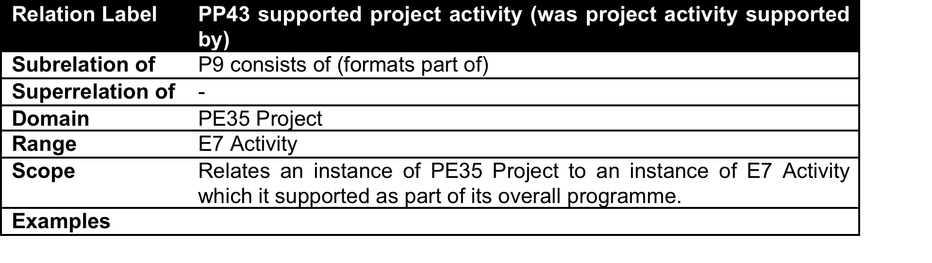
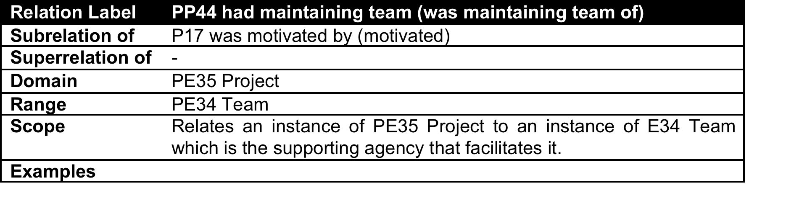
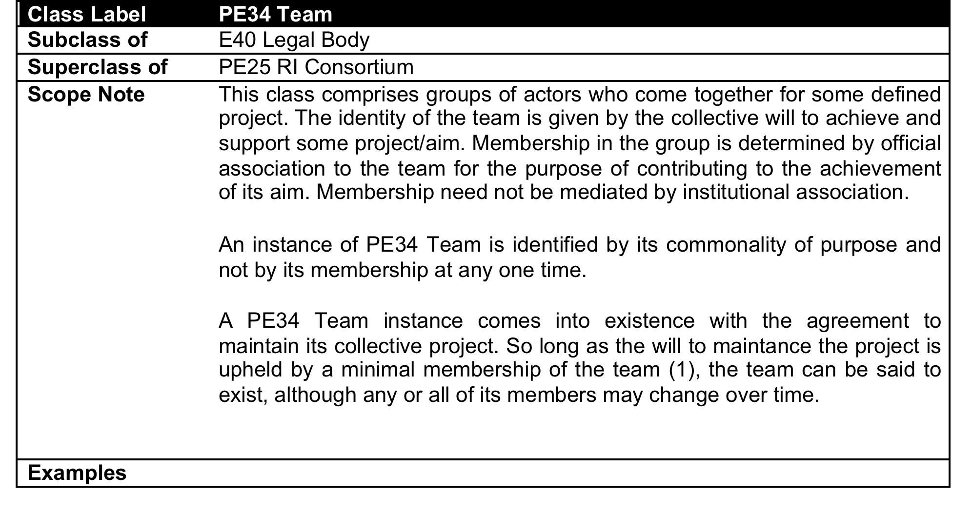
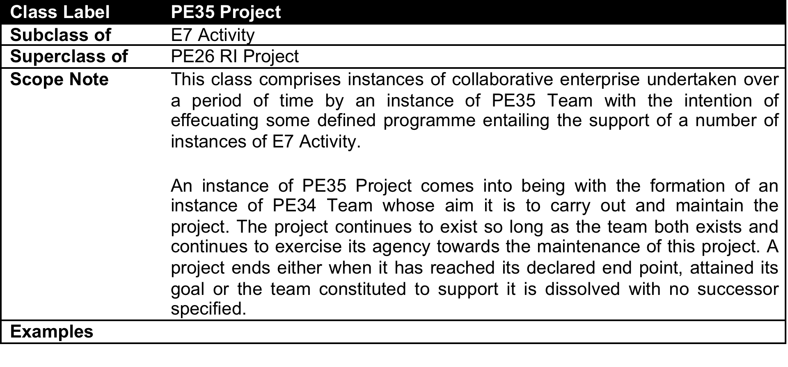
New Project and Actor Classes and Relations

Slide 6
Actors: New
E39 Actor
p107 has current or former member
E74 Group
E21 Person
E40 Legal Body
PE34 Team
PE25 RI Consortium

Slide 7
E-Service Pattern
PE38 Schema
pp28 has designated access point
PE29 Access Point
pp48 used protocol parameter
PE37 Protocol Type
PE8 E-Service
pp29 uses access protocol
D14 Software
pp47 had protocol type
pp2 offered by
pp7 hosts software object
E39 Actor
PE6 Software Hosting Service
p4 had time span
E52 Time Span
PE13 S/W Computing E- Service
PE14 Software Delivery E- Service
PE11 Software Curating Service
pp14 runs on request
pe15 delivers
on request
PE17 Curated S/W E- Service
D14 Software
D23 Volatile Software
pp12 curates software

Slide 8
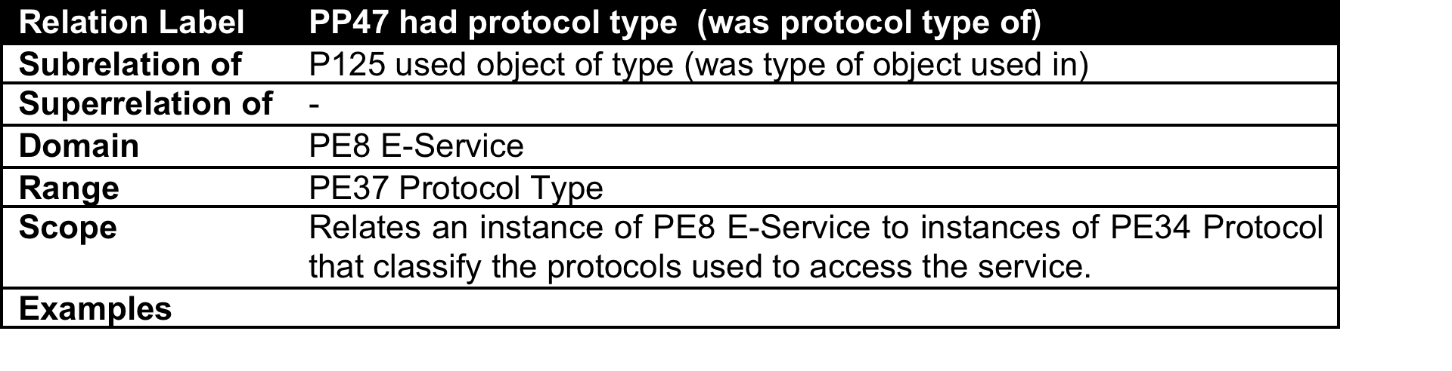
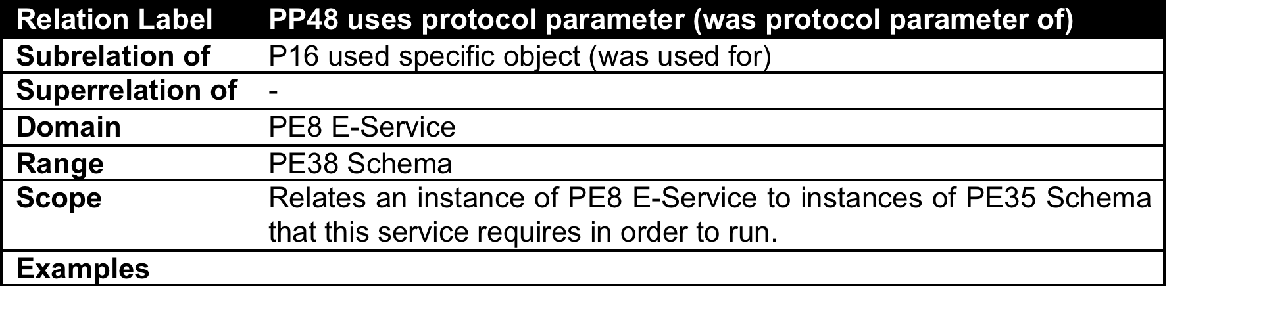
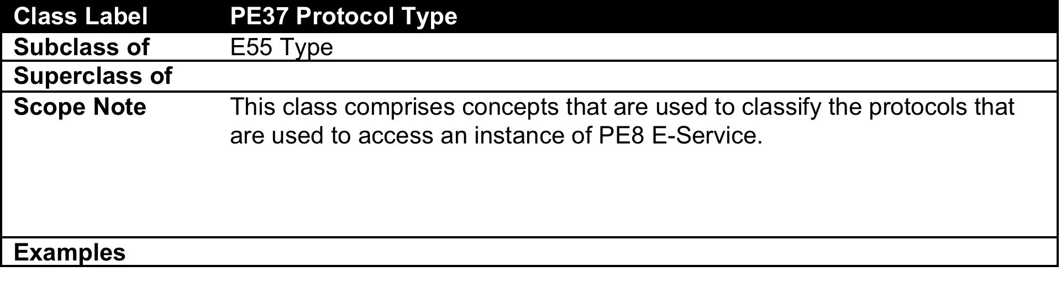
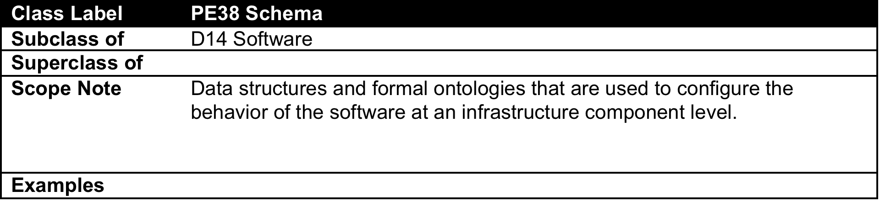
New E-Service Classes and Relations

Slide 9
E-Service/Hosting Pattern: Providing Access Points
E52 Time Span
p4 had time span
pp28 has designated access point
PE29 Access Point
E39 Actor
PE8 E-Service
PP49 Provides access point (was access point provided by)
pp2 offered by
PE29 Access Point
PE13 S/W Computing E- Service
PE14 Software Delivery E- Service
PE14 Data
E- Service
PP50 Accessible at (provides access to)
Pp7 hosts software
D1 Digital Object
pp8 hosts dataset
D14 Software
PE18 Dataset

Slide 10
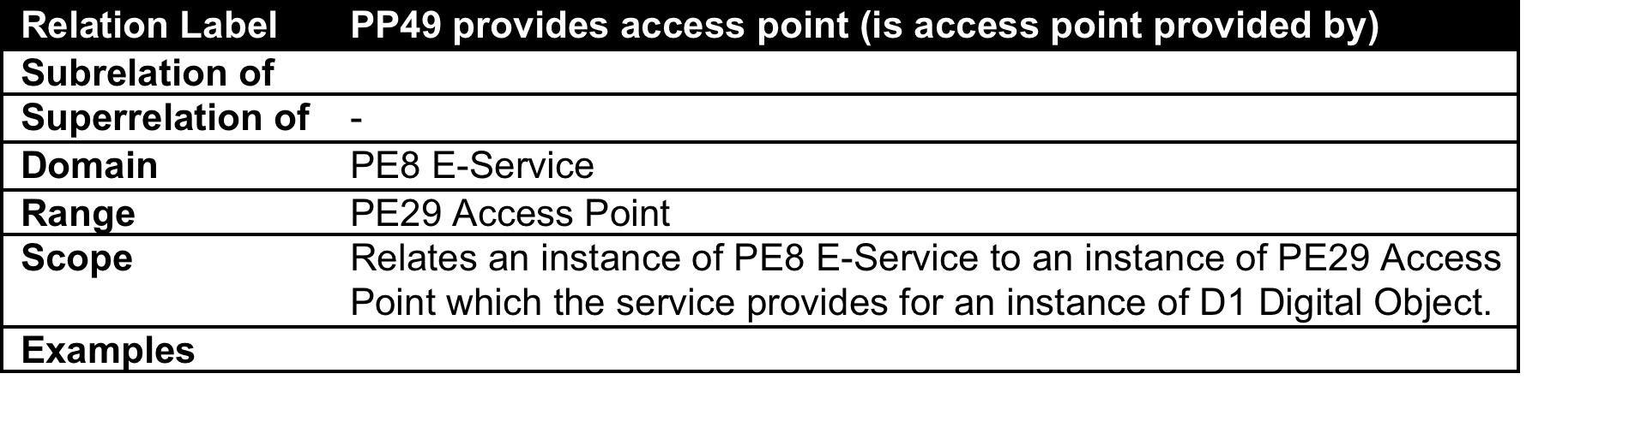
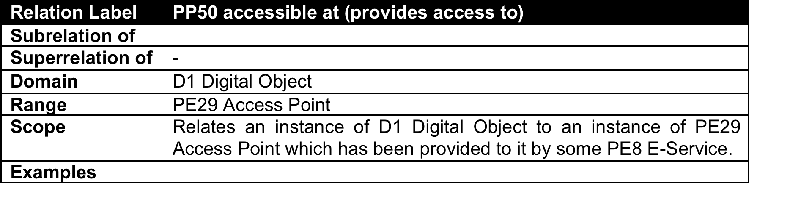
New E-Service Classes and Relations

Slide 11
Hosting and Access Triads
PP49 Provides access point (was access point provided by)
PE14 Software Delivery E- Service
PE29 Access Point
PP49 Provides access point (was access point provided by)
Pp7 hosts software
PE13 S/W Computing E- Service
PP50 Accessible at (provides access to)
PE29 Access Point
D14 Software
Pp7 hosts software
PP49 Provides access point (was access point provided by)
PP50 Accessible at (provides access to)
PE29 Access Point
D14 Software
PE14 Data
E- Service
pp8 hosts dataset
PP50 Accessible at (provides access to)
PE18 Dataset

Slide 12
Software: Schema
pp21 has software part
pp18 has volatile digital object part
D1 Digital Object
pp16 has persistent digital object part
pp17 has snapshot
D14 Software
PE19 Persistent Digital Object
PE20 Volatile Digital Object
pp19 has persistent software part
pp22 has release
PE21 Persistent Software
PE23 Volatile Software
PE38 Schema

