Slide 1
ARCHITECTURAL CONSERVATION PROCESS MODEL (CPM): Ontology as methodology for conservation project
Sapienza
Università di Roma
Donatella Fiorani*, Marta Acierno**
The 39th joined meeting of the CIDOC CRM SIG and ISO/TC46/SC4/WG9 and the 32nd FRBR - CIDOC CRM
Harmonization meeting
VASSILIKA VOUTON HERAKLION - CRETE
DATE: OCTOBER 09-12, 2017
*Full professor in Architectural Conservation, ** Researcher in Architectural Conservation

Slide 2
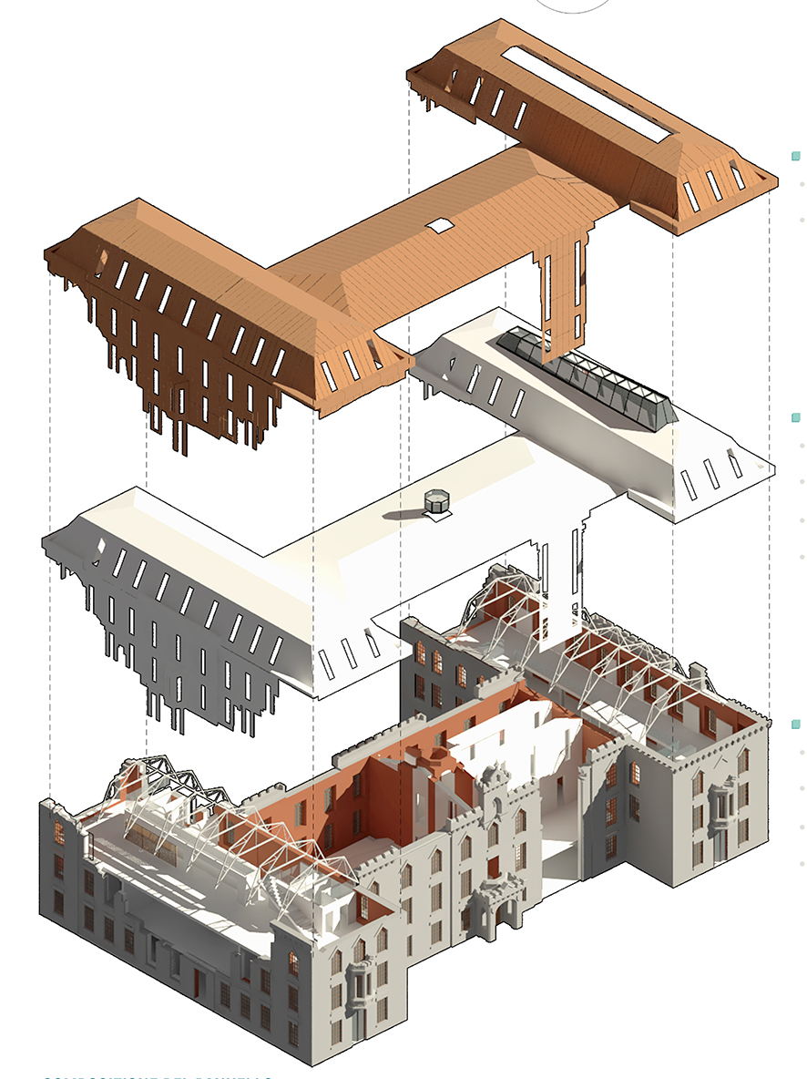
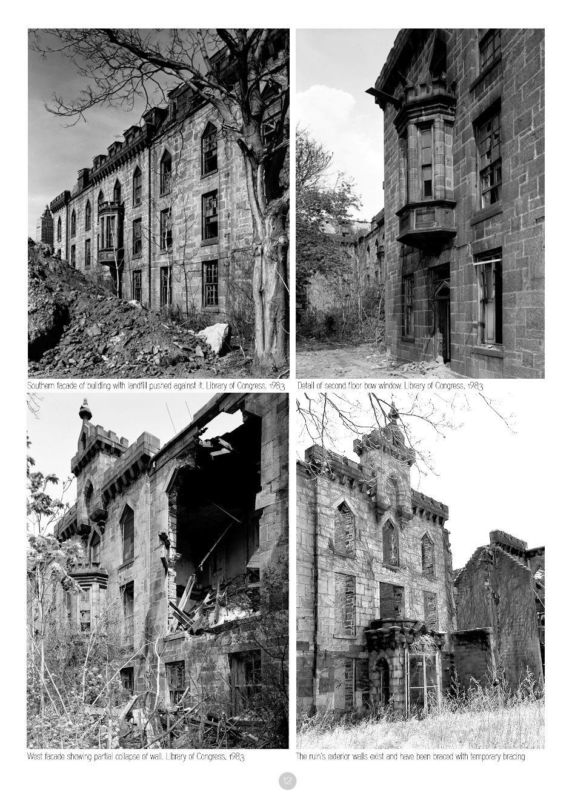
Sapienza
Università di Roma
Donatella Fiorani*, Marta Acierno**
ARCHITECTURE
MULTIDISCIPLINARY KNOWLEDGE
- ANALYSIS
(survey - diagnostic / geometrical, historical, typological, figurative, constructive, structural, material…)
ASSESSMENT
(building transformation, state of conservation, compatibility of uses)
CONSERVATION PROJECT
*Full professor in Architectural Conservation, ** Researcher in Architectural Conservation

Slide 3
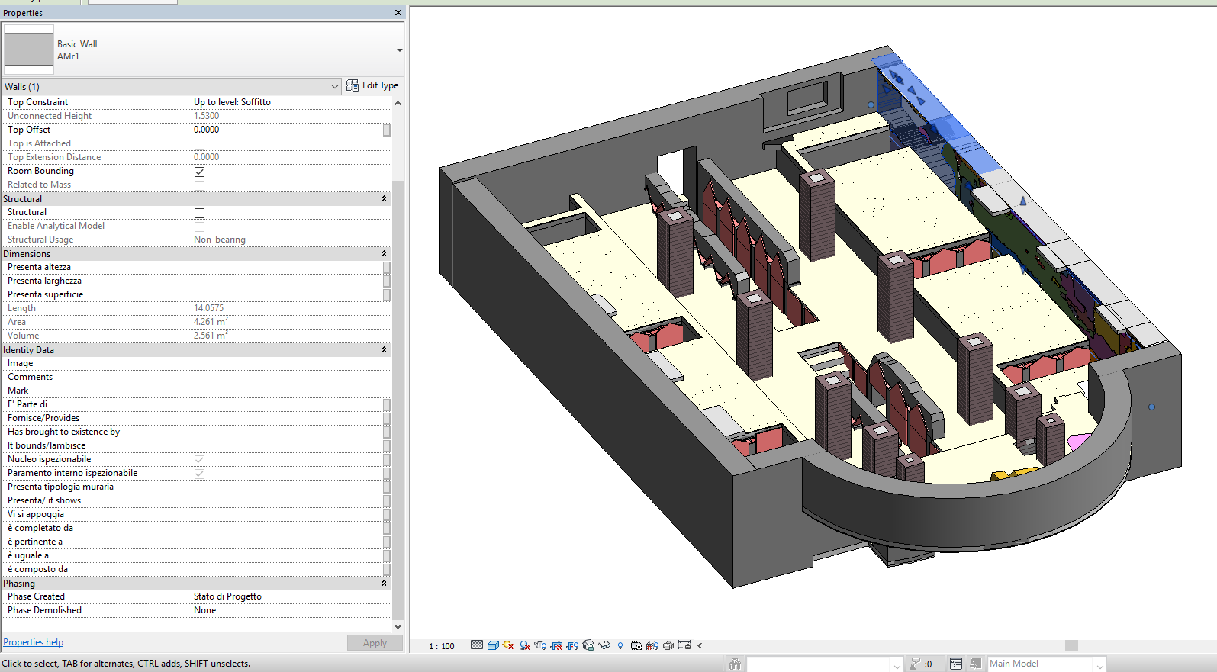
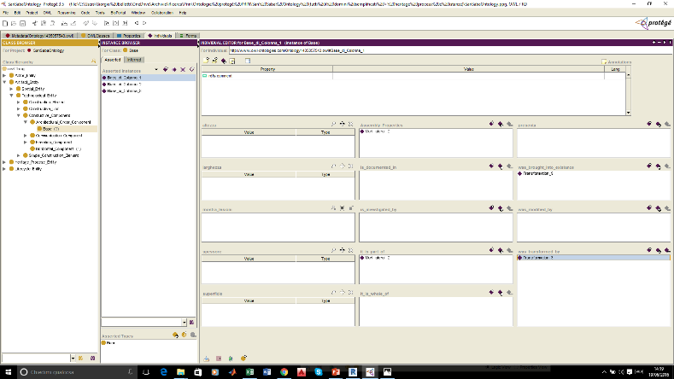
Sapienza
Università di Roma
How the research started
Donatella Fiorani, Marta Acierno
‘BHIMM - BUILT HERITAGE INFORMATION MODELLING AND MANAGEMENT’
(Research project of National Interest, five Italian universities: Milan, Genoa, Brescia, Torino, Rome)
working at:
ARCHITECTURAL HERITAGE CONSERVATION DESIGN REQUIREMENTS
highlighting :
LIMITS WITHIN BIM FOR ARCHITECTURAL CONSERVATION PROCESS
Research proposal:
REPRESENTATION THROUGH ONTOLOGY MODEL

Slide 4




Sapienza
Università di Roma
Architectural Heritage and Building Information Modeling
Donatella Fiorani, Marta Acierno
ARCHITECTURAL HERITAGE
Characteristic
BUILDING INFORMATION MODELING
Framework
Specificity - Unicity of Components
Parametric Representation Component-Based Approach
Complexity and Stratification
Limited level of semantic description
CONSERVATION DESIGN
Requirements
BUILDING INFORMATION MODELING
Framework
Collaboration and sharing of Design Solutions- Participation of many different Specialists (Architects, Engineers, Archaeologists, Biologists, Chemists, Physicians..)
Interoperability
Importance of Hermeneutical Process
Interaction between Study and Technical Proposal
The Knowledge Representation is exclusively referred to the Artifact Components

Slide 5
Sapienza
Università di Roma
An ad hoc Representation Framework
Donatella Fiorani, Marta Acierno
CONSERVATION PROCESS MODEL (CPM)
Conceptual representation that ensures :
Compliance to the disciplinary categories gathered by architecture
Semantic enrichment of representation
Flexibility (referring lexicons may be updated in progress)
Methodological advantages in the deeper comprehension of conservation domain
Methodological advantages in the better control of design process and structural relation between design and managing activities
CONSERVATION PROCESS MODEL (CPM)
Conceptual representation that pursues as aims:
a. Capturing and representing the semantic contents of architectural heritage and conservation process
b. Working up a model that may achieve integration, mediation and interchange of information in the midst of architectural heritage conservation

Slide 6
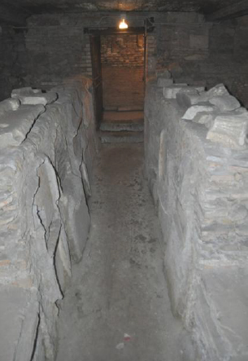
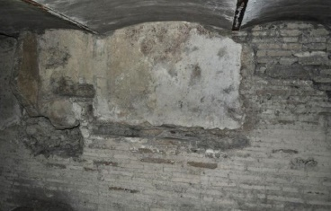
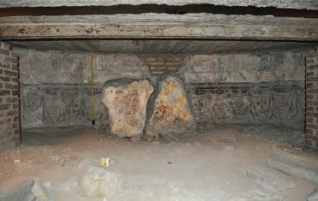
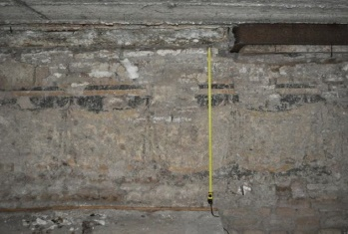
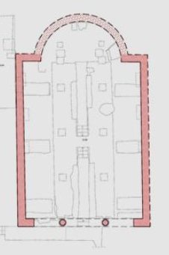
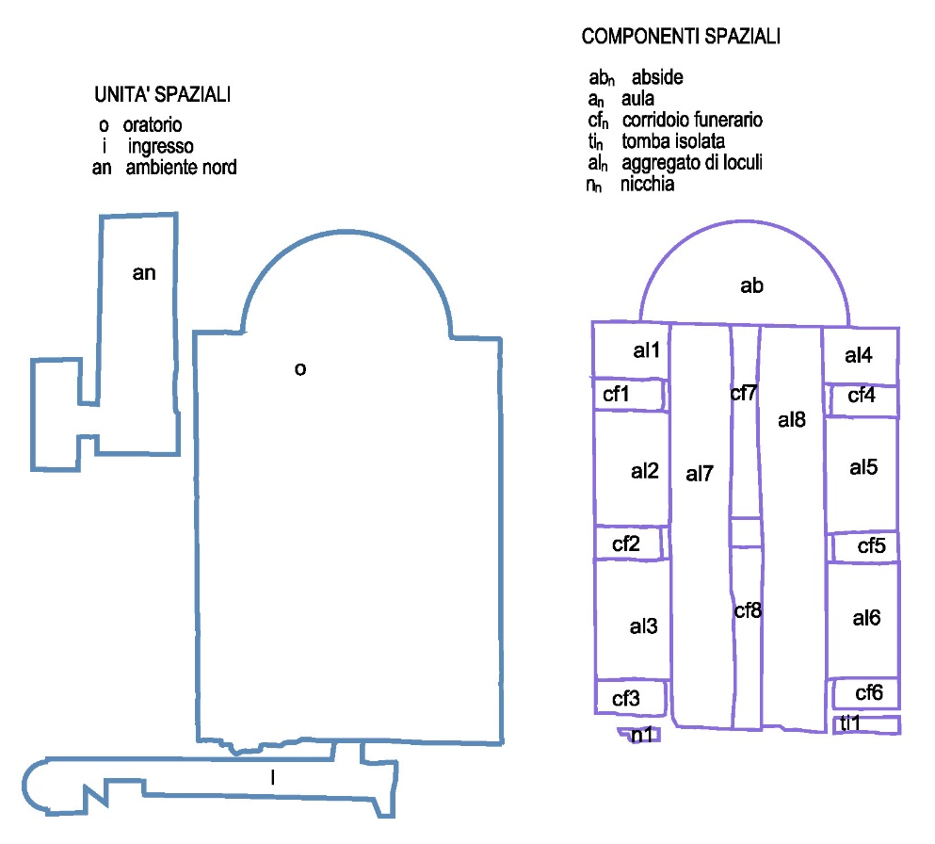
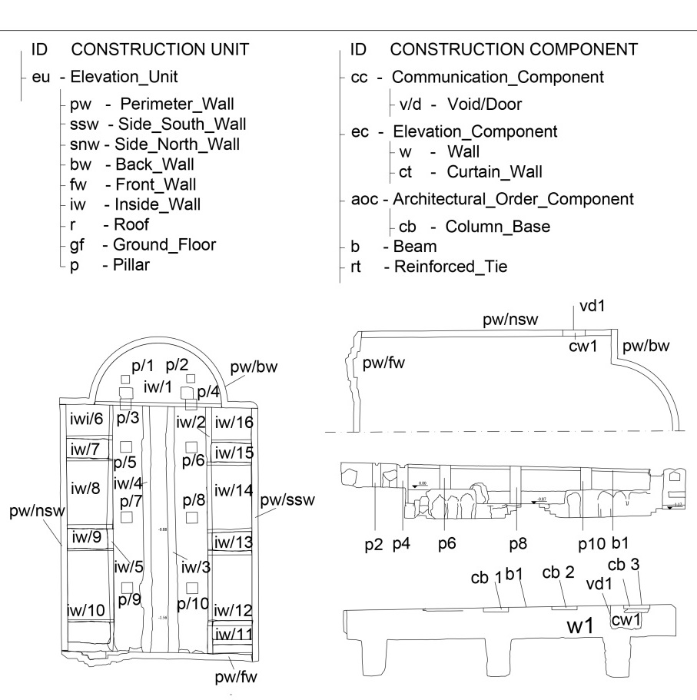
Sapienza
Università di Roma
CPM and existing ontologies
Donatella Fiorani, Marta Acierno
SPACES
ARCHITECTURE
BUILDING
Spatial units
O: Oratory
I: Entrance
an: Northern Room
Spatial components
ab: Apse
a: hall
cf: funerary corridor
ti: isolated tomb
al: graves aggregate
N: niche
ARTIFACT
Construction units
Construction components
SPATIAL ENTITIES
CONSTRUCTION ENTITIES
Cidoc CRm
ICOM
(International Council of Museums)
ISO 21127:2006
FRBRoo
AR
A. Guillem, G. Bruseker, P. Ronzino, 2016

Slide 7

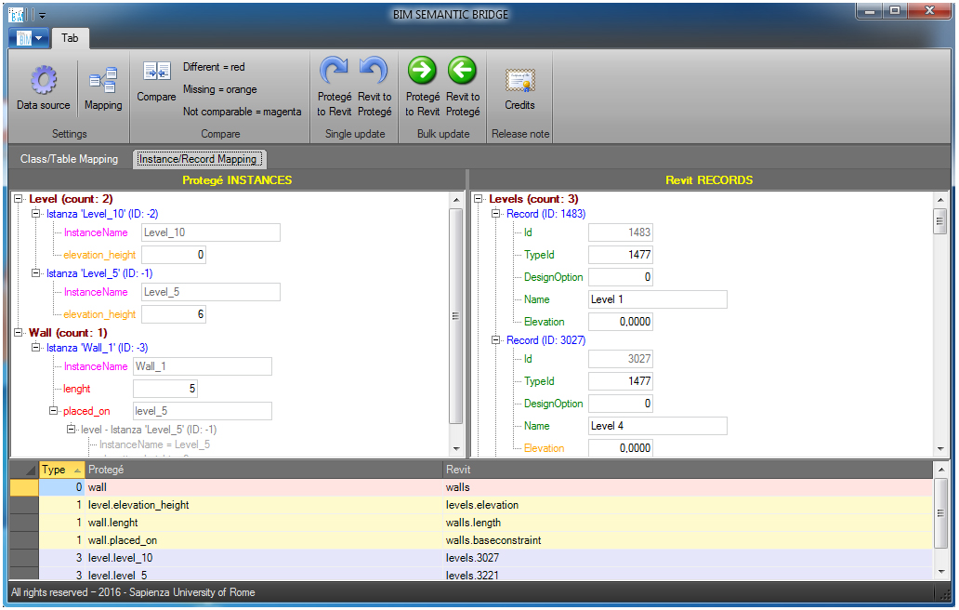
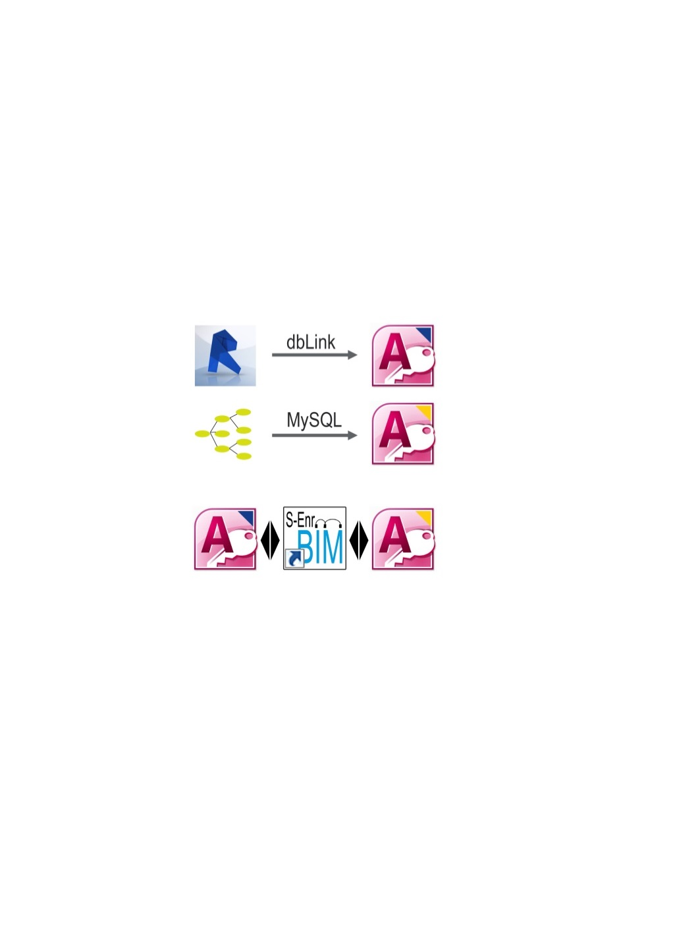
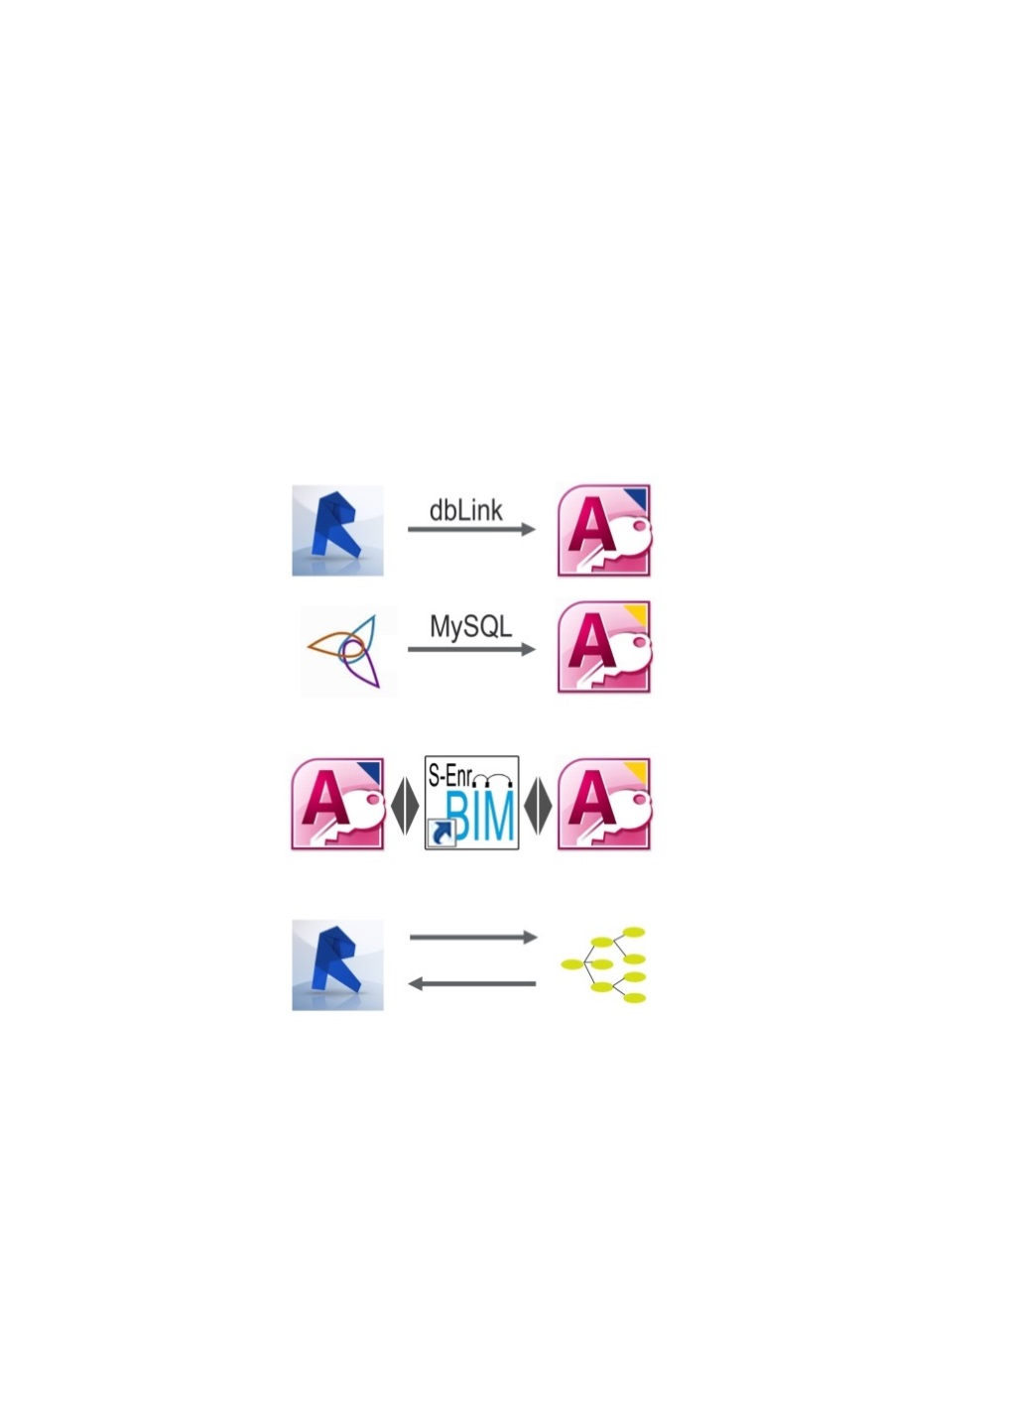
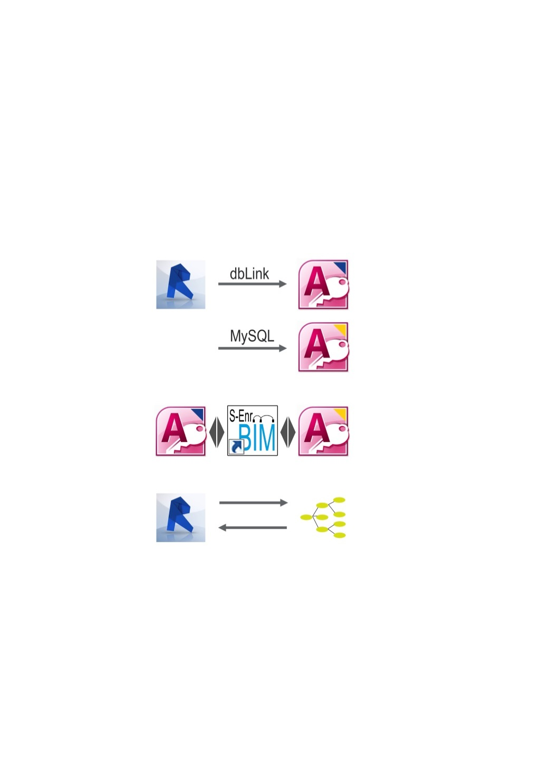

Sapienza
Università di Roma
Donatella Fiorani, Marta Acierno INTEROPERABILITY
Revit
Access
Protégé
Access
Access
Access
Protégé
Revit
The prototype works on synchronisation between instances of artefacts formalised within the ontology and the objects modelled in BIM. Software compares and updates databases gathered by the two programs .
File ‘mapping’ allows comparison instances of Revit model and ontology

Slide 8
Sapienza
Università di Roma
Donatella Fiorani, Marta Acierno
CPM: working on domains definition
Contents
Domains modelled within ontology
Architectural building
1. Artefact
Knowledge
2. Investigation process for historical buildings
3. Actors
Historical architectural
Material
State of conservation
Environment context
4. Lifecycle 1 Trasformation process for historical architetcure
Transformation phases
New integration
Conservation intervention
5. Lifecycle 2 Conservation and managing
Management
Planned conservation

Slide 9
Sapienza
Università di Roma
Artefact Domain Classes: Mapping
Donatella Fiorani, Marta Acierno
CODE |  |  |  |  | SCOPE NOTE | MAPPING WITH CIDOC CRM | CRITICAL ISSUES
EcpmA1 | Artifact Entity = E24 |  |  |  |  | E24 Physical Man-Made Thing
EcpmA2 |  | Spatial Entity |  |  | Entity refered to a space … |  | «An instance of E53 Place may consist of or form part of another instance of E53 Place, thereby allowing a hierarchy of geometric ‘containers’ to be constructed».
EcpmA3 |  |  | Building Unit |  | Building refered to…
EcpmA25 |  |  | Spatial Unit |  | Part of the building unit…
EcpmA36 |  |  |  | Oratory | It is a place of christianity…
EcpmA45 |  |  | Spatial Component |  | Part of the spatial unit that …
EcpmA64 |  | Constructive Entities |  |  | Complex element …
EcpmA65 |  |  | Construction unit |  | Complex element necessary for …
EcpmA80 |  |  | Construction component |  | Element that consists of the….
EcpmA144 |  |  | Construction element |  | Simple elment that …
EcpmA192 |  |  | Construction Material |  | Natural or artificial materials …
EcpmA237 |  | Movable elements |  |  | Furniture and decorative …

Slide 10
Sapienza
Università di Roma
Classes and Instances Encoding
Donatella Fiorani, Marta Acierno
Class
Cod. EcpmA36 | Oratory
Subclass of |  | Building
Superclass of | --
Scope note | It is a place of christianity, generally with small dimensions, intended to host private prayer and worship for families or communities.
Examples | San Saba Oratory
Properties | PcpmA01 |  | It is part of/it is whole of
 | PcpmA02 |  | It is bordered by
 | PcpmA04 |  | Has as a function
 | PcpmP06 |  | It is studied by
 | P123 |  | Results from
 | PcpmA10 |  | It has datation
 | PcpmA11 |  | Has area
 | PcpmA12 |  | It is hypogeal
 | PcpmA13 |  | It is accessible
 | PcpmA14 |  | It is visitable
Instance
Cod. EcpmA36_1 | Name: San Saba Oratory
Class | Cod EcpmA36 | Spatial Unity: Oratory
Object Properties | PcpmA01 | It is whole of | Spatial Components: Aula, Apse, Funerary corridor, Tomb, Tombs aggregate, Burial Niche, Isolated tomb
 | PcpmA01 | It is part of | Architectural units: San Saba Church (X)
 | PcpmP06 | It is studied by | Actors: Krautheimer, Delle Rose, Fiocchi Nicolai (X)
 | P123 | Results from | Trasformation (E81)
 | PcpmA11 | Has area | 155 m²
Data properties | PcpmA12 | It is hypogeal | boolean: si
 | PcpmA13 | It is accessible | Boolean: si
 | PcpmA14 | It is visitable | Boolean: no
Note

Slide 11
Sapienza
Università di Roma
Encoding Artefact Domain Properties
Donatella Fiorani, Marta Acierno
Object Properties
CODE | PROPERTY | DOMAIN | RANGE | MAPPING WITH CIDOC CRM | CRITICAL ISSUES
PcpmA1 | It is part of/it is whole of | Artefact | Artefact |  | May become inverse of: P45 consists of (is incorporated in) Inverse of P46 is composed of (forms part of)
PcpmA2 | It is bordered by | Artefact | Artefact | - Consists of
 |  |  |  | - Borders with (P122 )
PcpmA4 | It is studied by | Artefact | Actors
P123 | Results in | Artefact | Lifecycle 1
P08 | Is investigated by | Artefact | Investigationg prorces
Code: PcpmA2 | It is borded by
Domain | Cod EcpmA25 | Artefact_(Spatial Unit)
Range | Cod EcpmA80 | Artefact (Constructive Components)
Superproperty of | ---
Quantification | 1: many
Scope note | This property describes which are the Constructive Components that border the Spatial Unit
Examples | San Saba hall (Ecpm A45__1) is bordered by a perimeter wall (E cpmA80_pw1))

Slide 12
Sapienza
Università di Roma
Investigation Process Formalization
Donatella Fiorani, Marta Acierno
LEGEND
CIDOC CRM
carried_out_by (P14)
uses_as_input (PcpmP01)
CPM derived from CRM
Information_Object
(E73)
Actor (E39)
Information_
Object
(E73)
CPM custom
provides_as_output
(PcpmP06)
Is-a (PcpmA05)
Heritage_ Process_ Resource (EcpmP32)
by_means_of (PcpmP02)
Heritage_Process_Investigation (EcpmP02)
Subclass of Heritage Process Activity (Subclass of E5 Event)
provides_information_for (PcpmP05)
Investigation_
Method
(EcpmP49)
applied_to
(PcpmP03)
Attribute_Assignment (E13)
Artifact_Entity
Macro-Domain (EA1= EL24 Physical Man-Made Thing)
Investigation_
Tool
(EcpmP50)
applied_to
(PcpmP03)
collected_from (PcopmP04)
assembly properties
(part of/whole of (PcpmA01)
Investigation_
Sample
(EcpmP112)
Artifact_Entity
(EA1 = E24 Physical Man-Made Thing)

Slide 13
Sapienza
Università di Roma
Encoding Investigation Process Activity
Donatella Fiorani, Marta Acierno
CODE | CLASS NAME
E_{pcm}P2 | Heritage Process Entity
E_{pcm}P3 |  | Heritage Process Activity
E_{pcm}P03 |  |  | Heritage Indirect investigation
E_{pcm}P04 |  |  |  | Documental Investigation Activity
E_{pcm}P05 |  |  |  | Bibliographical Investigation Activity
E_{pcm}P06 |  |  |  | Comparing Analysis Activity
E_{pcm}P07 |  |  |  |  | Formal Analysis
E_{pcm}P08 |  |  |  |  | Typological Analysis
E_{pcm}P09 |  |  | Heritage Direct Investigation Activity
E_{pcm}P10 |  |  |  | Survey Activity
E_{pcm}P11 |  |  |  |  | Geometrical Survey
E_{pcm}P12 |  |  |  |  | Architectural Survey
E_{pcm}P13 |  |  |  | Materials macro-characterization Activity
E_{pcm}P14 |  |  |  | Masonry Investigation Activity
E_{pcm}P15 |  |  |  |  | Masonry types investigation
E_{pcm}P16 |  |  |  |  | Stratigraphic investigation
E_{pcm}P17 |  |  |  | Constructive techniques analysis Activity
E_{pcm}P18 |  |  |  | Morphological Analysis Activity
E_{pcm}P19 |  |  |  |  |  | Metrological analysis
E_{pcm}P20 |  |  |  |  |  | Walls thickness analysis
E_{pcm}P21 |  |  |  |  |  | Geometrical analysis
Heritage Direct investigation
E_{pcm}P23 | Diagnostic Activity
E_{pcm}P24 |  | Decay Survey Activity
E_{pcm}P25 |  |  | Structural Decay Survey
E_{pcm}P26 |  |  | Material Decay Phenomena
E_{pcm}P27 |  |  | Material Decay Phenomena Distribution Survey
E_{pcm}P28 |  | Structural Diagnostic Activity
E_{pcm}P29 |  | Biological Diagnostic Activity
E_{pcm}P30 |  |  | Biological Alterations Study (Macro-Activity)
E_{pcm}P31 |  |  | Visual Investigations
E_{pcm}P32 |  |  | Crop Analysis
E_{pcm}P33 |  |  | Bimolecular Analysis
E_{pcm}P34 |  |  | Biochemical Analysis
E_{pcm}P35 |  |  | Environmental Contamination Check (Macro-Activity)
E_{pcm}P36 |  |  | Microbe Air Quantity Survey
E_{pcm}P37 |  |  | Microbe Surfaces Quantity Survey
E_{pcm}P38 |  |  | Insectile Monitoring
E_{pcm}P39 |  |  | Biological Material Characterization (Macro-Activity)
E_{pcm}P40 |  | Chemical Diagnostic Activity
E_{pcm}P41 |  |  | Chemical Alteration Study (Macro-Activity)
E_{pcm}P42 |  |  | Visual investigation
E_{pcm}P43 |  |  | Material Chemical Variation Monitoring Test
E_{pcm}P44 |  |  | Salt Efflorescence Qualification
E_{pcm}P45 |  |  | Chromatic Variation Analysis
E_{pcm}P46 |  | Physic Diagnostic Activity
E_{pcm}P47 |  |  | Microclimate Diagnostic Activity (Macro-Activity)
E_{pcm}P48 |  |  | Preliminary Survey
E_{pcm}P49 |  |  | Survey Campaign

Slide 14
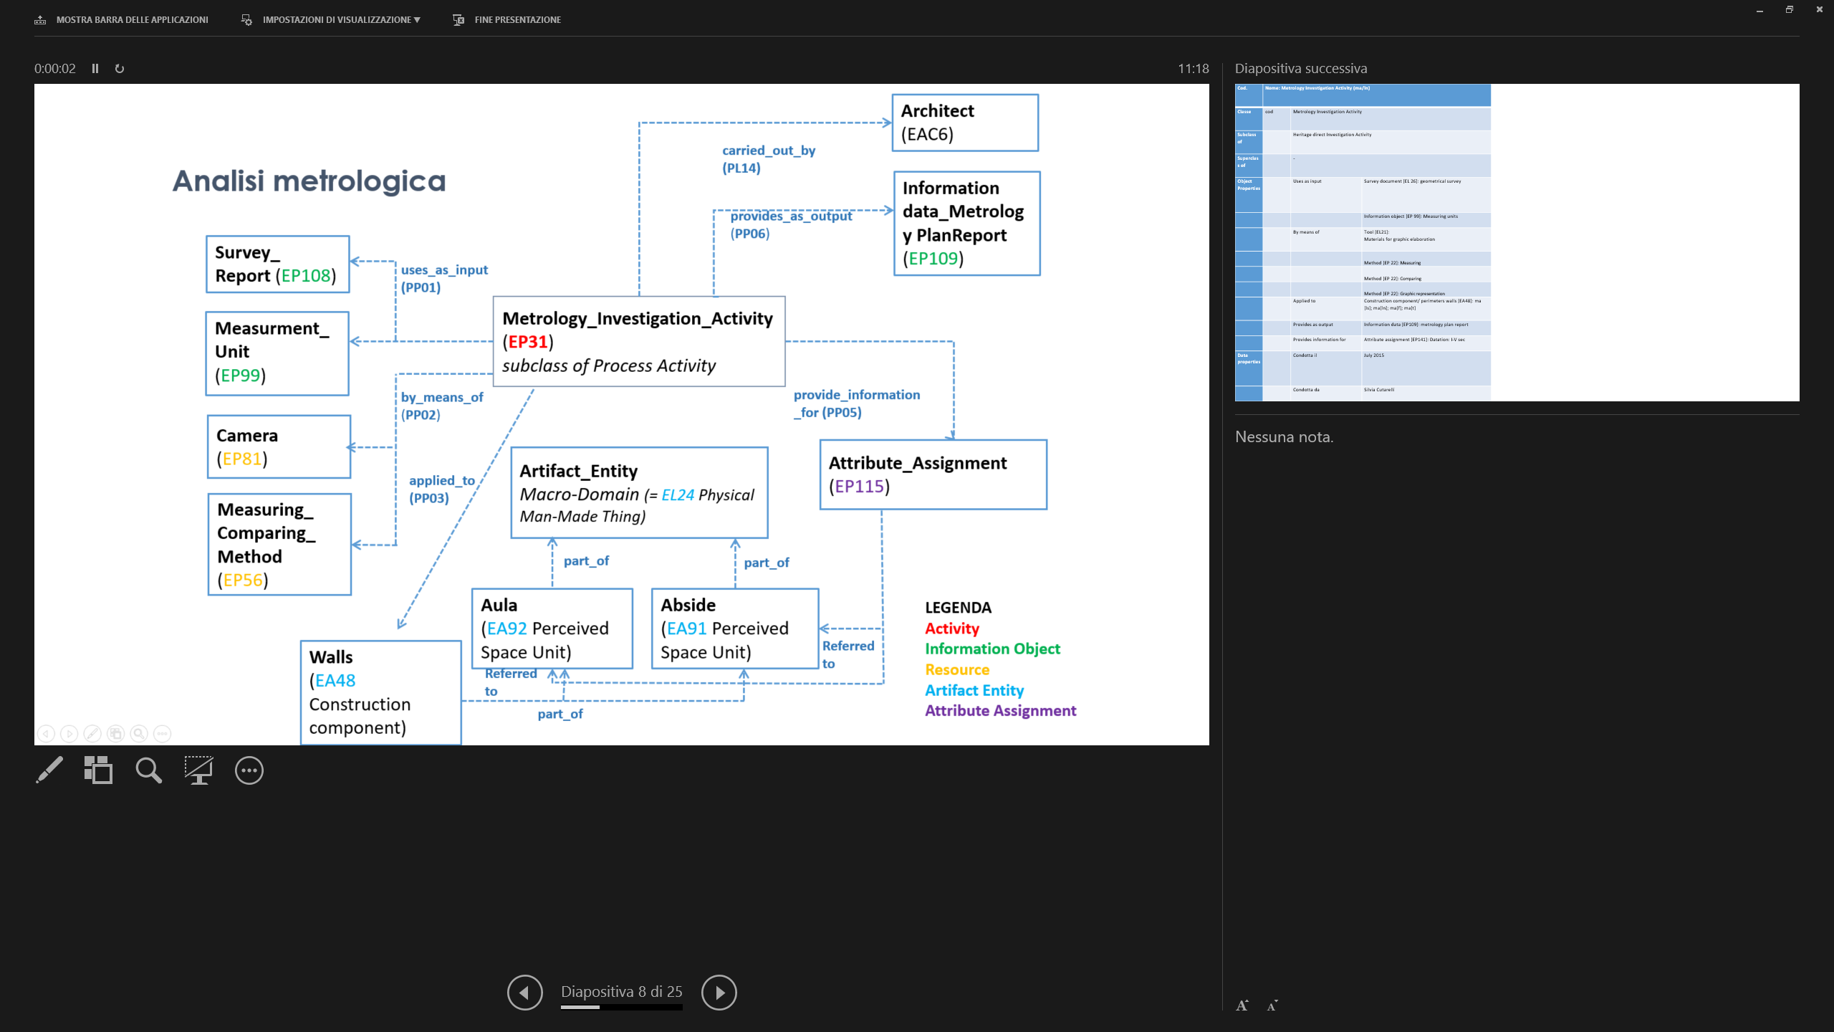
Sapienza
Università di Roma
Investigation process: Metrology Investigation
Donatella Fiorani, Marta Acierno
Information data_Metrology Plan Report (EP109)

Slide 15
Cod. E_{pcm}P19 | Instance Name: Metrology Investigation Activity (pv/ssw)
Classe | Cod E_{pcm}P19 | Metrology Investigation Activity
Subclass of | Cod E_{pcm}P03 | Heritage Direct Investigation Activity
Superclass of |  | -
Object Properties | Cod PcpmP01 | Uses as input | Survey document [EL 26]: geometrical survey
 |  |  | Information object [EP 99]: Measuring units
 | Cod PcpmP02 | By means of | Tool [EL21]: Materials for graphic elaboration
 |  |  | Method [EP 22]: Measuring
 |  |  | Method [EP 22]: Comparing
 |  |  | Method [EP 22]: Graphic representation
 | Cod PcpmP03 | Applied to | Construction component/ perimeters walls [EA48]: pw [ssw]; pw[nsw]; pw[fw]; pw[bw]
 | Cod PcpmP06 | Provides as output | Information data [EP109]: metrology plan report
 | Cod PcpmP05 | Provides information for | Attribute assignment [EP141]: Datation: I-V cent.
 | Cod P14 | Carried out by | Silvia Cutarelli

Slide 16
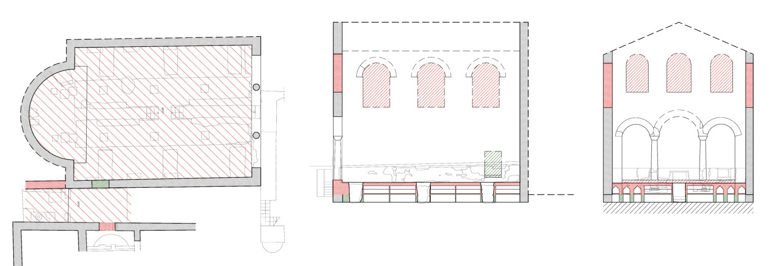
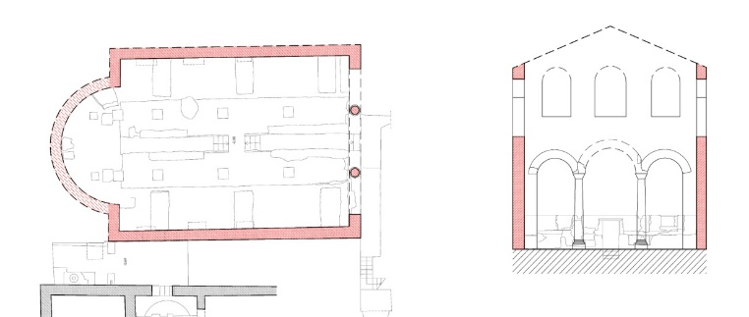
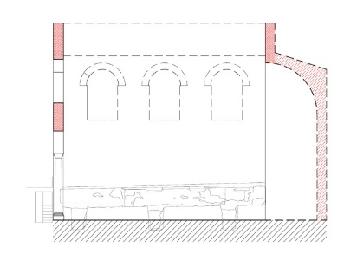
Sapienza
Università di Roma
Donatella Fiorani, Marta Acierno
Past Building Information (Lifecycle 1)
Aggregate of graves
(EA58 Spatial components)
Addition of spatial components
(EL81.1 Transformation_ part addition)
San Saba Oratory with Cemetery
(EA1Artifact_Entity =
EL24 Physical Man-Made Thing)
resulted_in
(P123)
realized through
(PcpmL140)
Curtain walls
(Ecpm A125 Construction components)
Addition of construction components
(EL81.1 Transformation_part addition)
resulted_in
(P123)
Transformation in monastic Oratory (late VI-beginning VII cent.)
Krautheimer
(EL21Person)
Adaptation of the Roman Hall to Oratory with Cemetery
(EL81 Transformation)
carried_out_by (P14)
provides_as_output (PcpmP06)
Krautheimer Investigation
(EP04 Investigation_Activity)
Krautheimer, 1974, p.4
(EL31Document)
was_trasformed_by (P124)
investigated by (PcpmP08)
Roman Hall of San Saba
(EL24 Physical_Man-made_Thing)
Roman Building
(EL24 Physical_Man-Made_Thing)
Aventino Minore
(EL53 Place)
First building: hall with apse (late IV-beginning V cent.)
is part_of
has_current_location
(P53)
resulted_in
(P123)
Domains: Legend
Roman Domus
(EL24 Physical_Man-Made_Thing)
Hall construction
(EL81 Transformation)
1.Artefact
3. Actors
was_trasformed_by (PL124)
2. Investigation process
4. Lifecycle 1

Slide 17
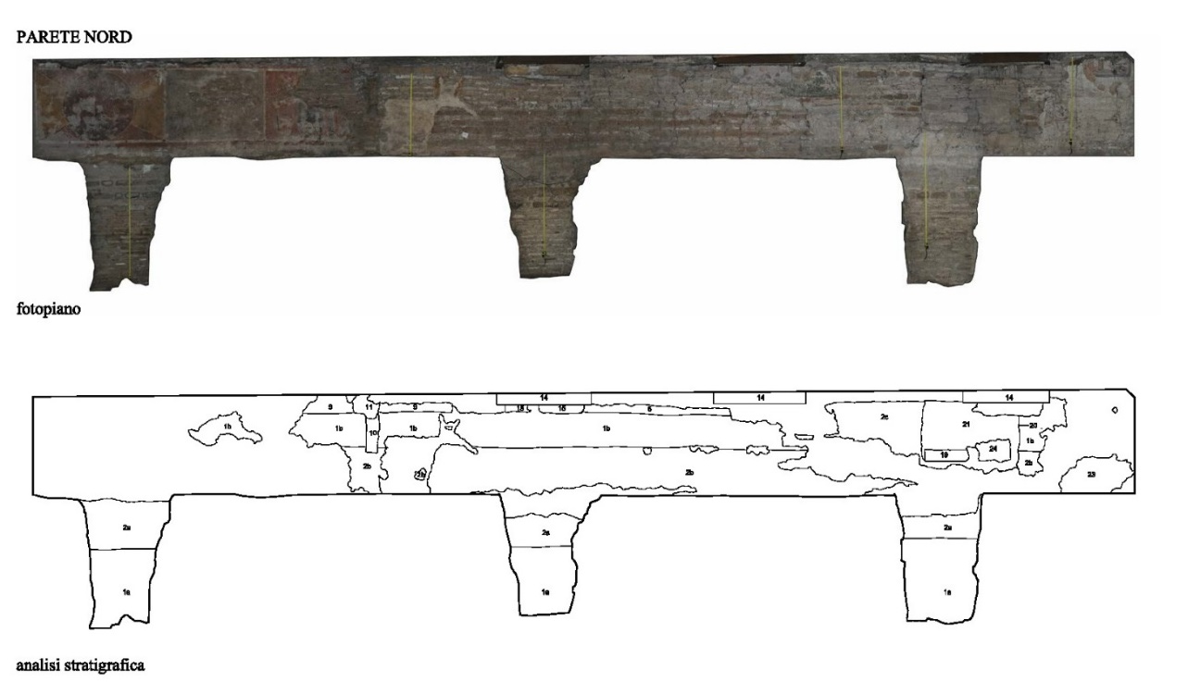




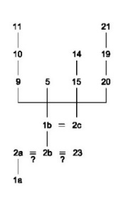


Sapienza
Università di Roma
Encoding Actors and Inferential Process
Donatella Fiorani, Marta Acierno
Code | CLASS NAME
E39 | Actor Entity
EcpmAc1 | - |  | Biologist
Ecpm3 | - |  | Chemist
Ecpm4 | - |  | Physicist
Ecpm5 | - |  | Archaeologist
Ecpm6 | - |  | Architect
EcpmAC13 |  |  | Materials Expert
Ecpm7 | - |  | Geologist
Ecpm8 | - |  | Process Manager
Ecpm9 | - |  | Restorer
Ecpm10 | - |  | Structural Engineer
Ecpm AC11 | - |  | Survey Expert
EcpmAC12 | - |  | User
Rules, formalized through swrl language
‘Wall_Unit’ (?a0) ∧ ‘Wall_Unit’ (?a1) ∧ ‘WallUnitInterpretedAge’ (?a0, ?age1) ∧ ‘WallUnitInterpretedAge’ (?a1, ?age2) ∧ ‘cover’ (?a0, ?a1) ∧ ‘swrlb:greaterThanOrEqual’ (?age2, ?age1) → ‘temporal_relationship_incoherence’ (?a1, true) ∧ ‘temporal_relationship_incoherence’ (?a0, true)

Slide 18
Sapienza
Università di Roma
Formalizing Conservation Project
Donatella Fiorani, Marta Acierno
Design or Procedure
(Cidoc: E29)
Expression
(FRBRoo: F2)
No reference to the intellectual and expressive components of architecture design
No reference to technical issues of architecture design
Merging contents into
Architectural Model
(AR: AR1)
No reference to hermeneutical process
Architectural Conservation Project (E_{cpm} 4)

Slide 19
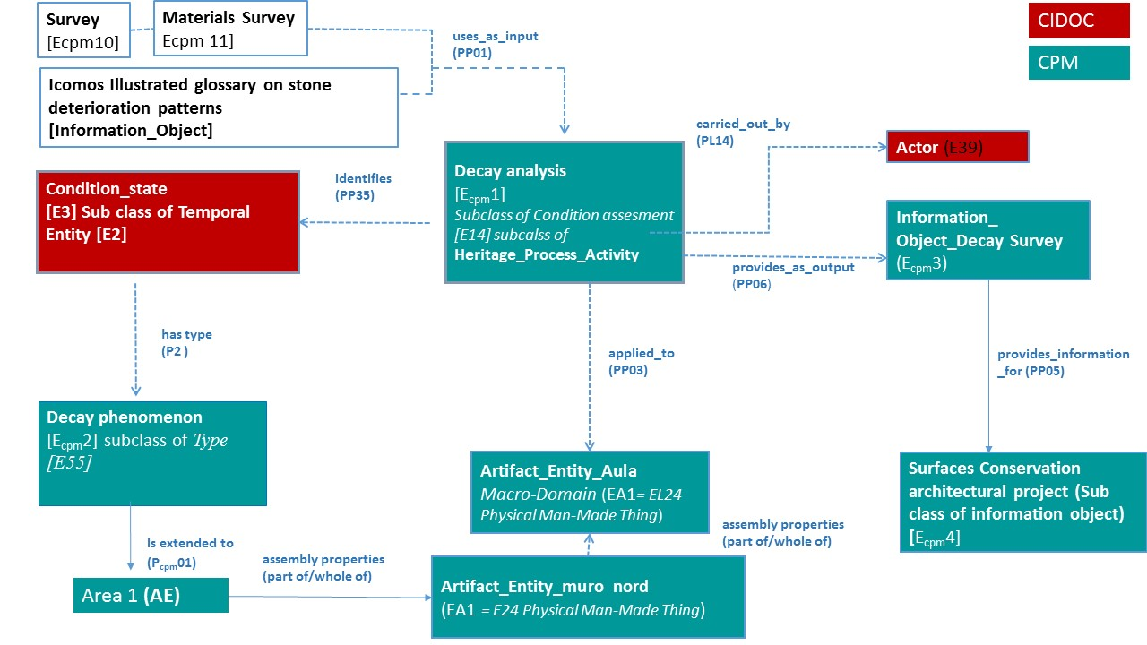
Donatella Fiorani, Marta Acierno

Slide 20
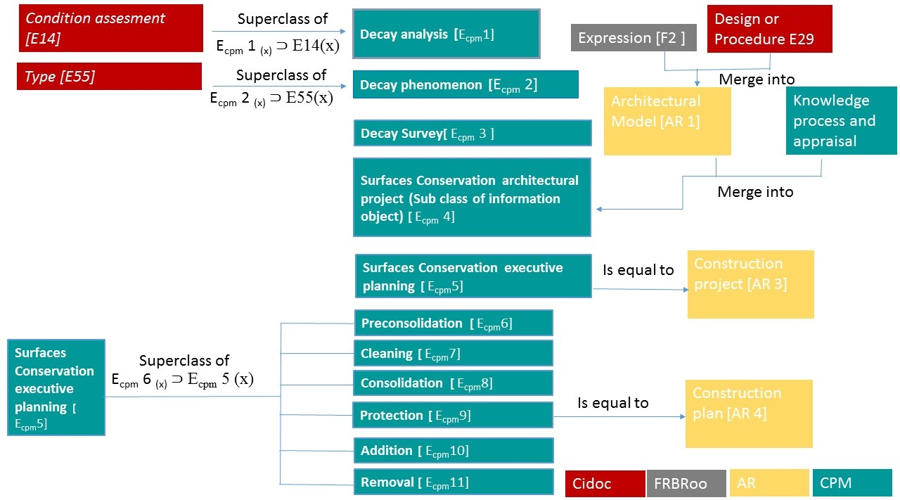
Sapienza
Università di Roma
Donatella Fiorani, Marta Acierno
Formalizing Conservation Project (Lifecycle 2)
SUBCLASS OF CURRENT ACTIVITY

Slide 21
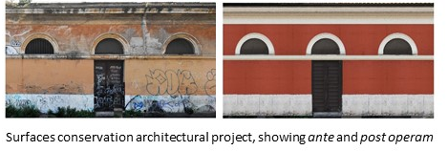
Sapienza
Università di Roma
Donatella Fiorani, Marta Acierno
Conservation Project (Lifecycle 2)
Uses_as_input
[PcpmP01]
Decay Survey
(Subclass of infromation object) [Ecpm3]
Provides_as_output [Pcpm06]
Surfaces Conservation architectural project (Subclass of information object) [Ecpm04]
Provides_as_output [Pcpm06]
Surfaces Conservation executive planning [Ecpm05
(subclass of activity E7)
Cidoc
Cpm
Preconsolidation [Ecpm06]
Is applied to [PcpmP03]
Is realized through
Cleaning [Ecpm 07]
Surface area [EcpmA241] (subclass of artefact entity)
Consolidation
[Ecpm08]
Has type (P2)
Istitutional Intervention lists[Epcm12]
(PcpmL269)
Forsees use of [PcpmL268]
Protection
[Ecpm09
Is part of
Addition [Ecpm10]
Material [E57]
Artefact entity (EA1=E24 Physical Man Made Thing)
Removal [Ecpm11]

Slide 22
Sapienza
Università di Roma
Donatella Fiorani, Marta Acierno
The End
THANK YOU FOR YOUR ATTENTION

