Slide 1
Recording absence
“This book does not have tooled decoration”
  It’s a cheap book

Slide 2
Recording absence (Oct 2019)
Solution 1: at an E55 Type
  too many composite terms
Solution 2: P57
  tooled decoration (E25 Human-Made Feature) → P57 has number of parts → 0
  E25 HMF is not a thing but gets a URI
Solution 3: Negative properties
  cover(E22 Human-Made Object) → NOT P56 bears feature → tooled decoration(E25 Human-Made Feature)
  E25 HMF is not a thing but gets a URI
  Produce NOT properties, plus their inverses
Solution 3+: Negative properties with E55 Types
  cover(E22 Human-Made Object) → NOT P56 bears feature → tooled decoration(E55 Type)
  Perhaps all negative properties have range E55 Type
  Identify possible negative properties in CRM

Slide 3
Recording absence (Feb 2020)
Negative statements should allow querying for contradictions

Slide 4
Recording absence (Feb 2020)
Negative statements should allow querying for contradictions
How to identify contradictions here:
  cover(E22 Human-Made Object) → P56 bears feature → tooled decoration(E26 Human-Made Feature)
  cover(E22 Human-Made Object) → NOT P56 bears feature → tooled decoration(E55 Type)

Slide 5
Recording absence (Feb 2020)
Negative statements should allow querying for contradictions
How to identify contradictions here:
  cover(E22 Human-Made Object) → P56 bears feature → tooled decoration(E26 Human-Made Feature)
  cover(E22 Human-Made Object) → NOT P56 bears feature → tooled decoration(E55 Type)
Introduce positive typed property first:
  cover(E22 Human-Made Object) → Pxa bears feature of type → tooled decoration(E55 Type)
  cover(E22 Human-Made Object) → Pxb does not bear feature of type → tooled decoration(E55 Type)

Slide 6
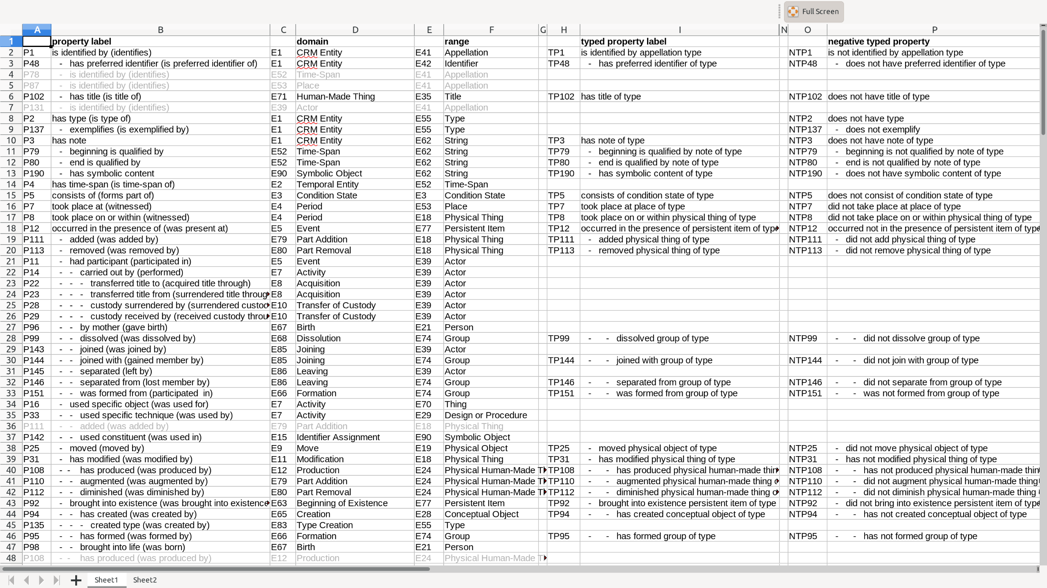

Slide 7
Extra 100 properties!

Slide 8
Recording absence (Feb 2020)
FOL!
  Pxa(x,y) ⊃ E22(x)
  Pxa(x,y) ⊃ E55(y)
  Pxa(x,y) ⊃ ∃ z, (P56(x,z) AND P2(z,y))
  Pxb(x,y) ⊃ E22(x)
  Pxb(x,y) ⊃ E55(y)
  Pxb(x,y) ⊃ ∄ z, (P56(x,z) AND P2(z,y))

Slide 9
Recording absence (Feb 2020)
Cannot point to z!
FOL!
  Pxa(x,y) ⊃ E22(x)
  Pxa(x,y) ⊃ E55(y)
  Pxa(x,y) ⊃ ∃ z, (P56(x,z) AND P2(z,y))
  Pxb(x,y) ⊃ E22(x)
  Pxb(x,y) ⊃ E55(y)
  Pxb(x,y) ⊃ ∄ z, (P56(x,z) AND P2(z,y))

Slide 10
Recording absence (Feb 2020)
One axiom per statement:
  E22(x) ∧ P2(y,”tooled decoration”) → ¬P56(x,y)

Slide 11
Recording absence (Feb 2020)
How do I implement that?
One axiom per statement:
  E22(x) ∧ P2(y,”tooled decoration”) → ¬P56(x,y)

Slide 12
E1 Entity
My book
E89 Propositional Object ?
ENxx Negative Statement
E55 Type
crm:P56_bears_feature
E55 Type
“tooled decoration”

Slide 13
E1 Entity
My book
E89 Propositional Object ?
ENxx Negative Statement
E55 Type
crm:P56_bears_feature
E55 Type
“tooled decoration”
Nobody likes reification.

Slide 14
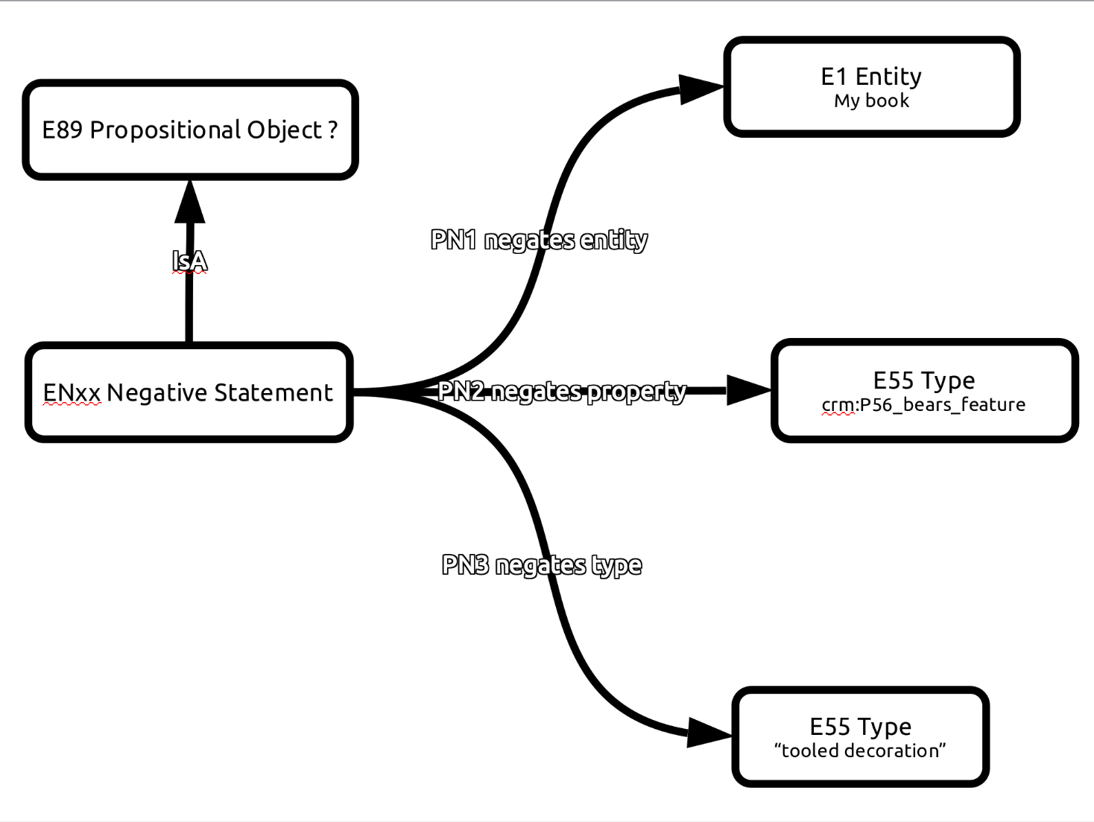
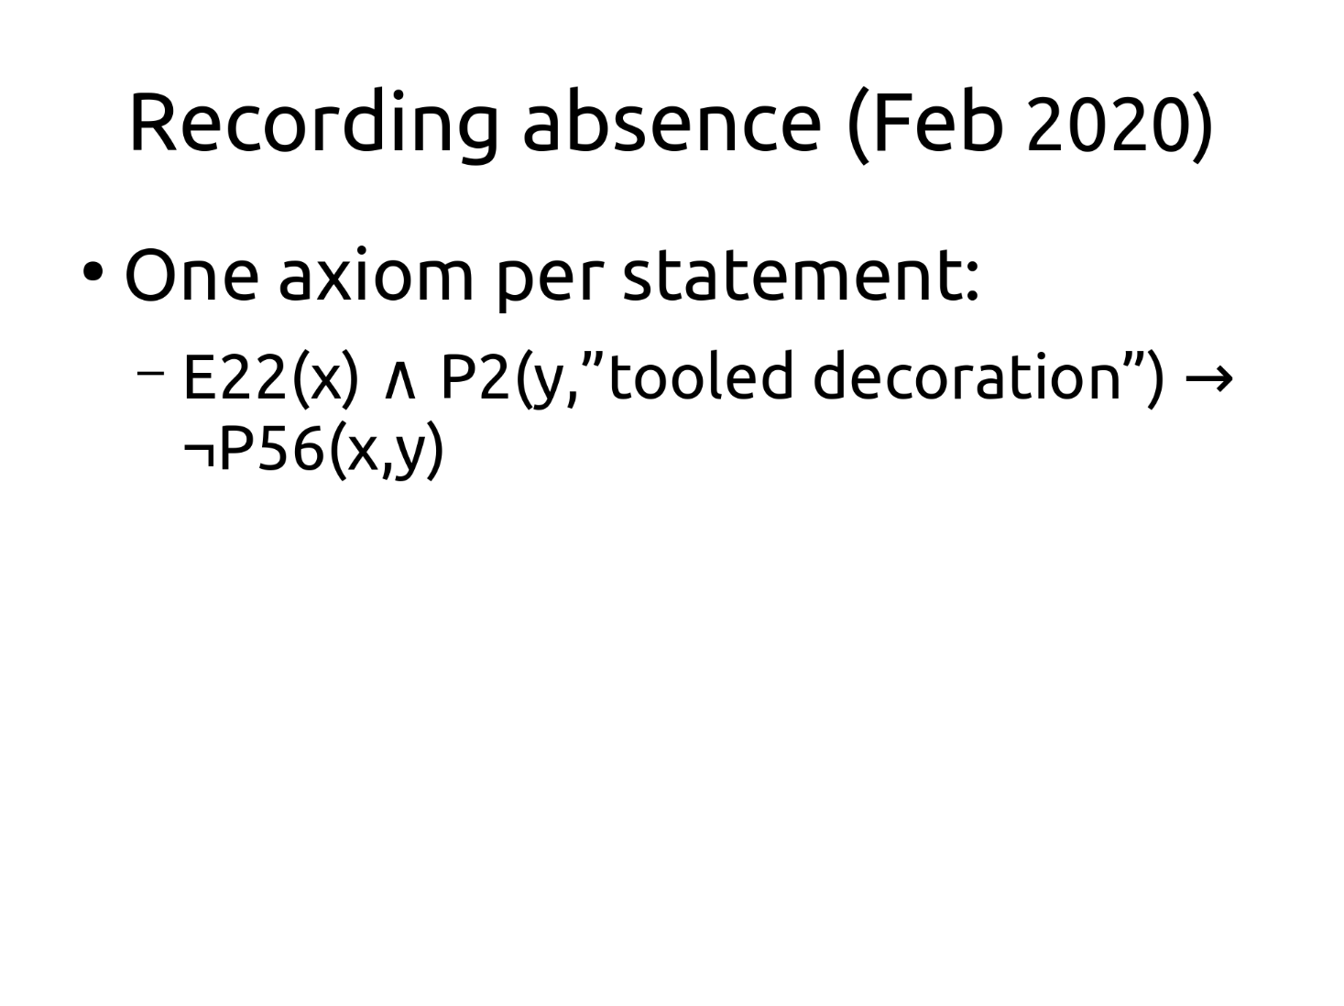
1
2
3

