Slide 1

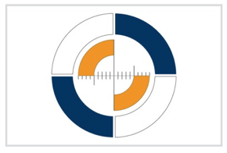
Alpine Copper II, Innsbruck, 21. – 23.09.2016
Unit for Surveying and Geoinformation, University of Innsbruck
Information integration in prehistoric mining archaeology
Gerald Hiebel, Klaus Hanke, Unit for Surveying and Geoinformation, University of Innsbruck
Gert Goldenberg, Caroline O. Grutsch, Markus Staudt, Institute of Archaeologies, University of Innsbruck
Notes:
The next 15 minutes we are going to deal with “Titel”. Unfortunately one of the co-authors, Joachim Lutz can‘t be here today – I will try to answer your questions with all the tools he tought me until now.

Slide 2
Alpine Copper II, Innsbruck, 21. – 23.09.2016
Overview
Research Questions – Why do we want to integrate information?
Information Sources – What sources do we have to integrate?
Integration model - How can we integrate on a theoretical level? What do we need?
Actual integration - How can we integrate on a practical level? What are the steps?
Products of the integration – How do we try to answer the research questions?
Notes:
The next 15 minutes we are going to deal with “Titel”. Unfortunately one of the co-authors, Joachim Lutz can‘t be here today – I will try to answer your questions with all the tools he tought me until now.

Slide 3
Alpine Copper II, Innsbruck, 21. – 23.09.2016
Research Questions
Where are physical structures, objects or samples that are relevant for prehistoric mining/metallurgy research? What do they look like?
To which technologies do these physical things relate?
How are these physical things dated, what methodology was used?
What is the geochemical signature of samples and artefacts?
Where do I find topographic structures relevant for prehistoric mining/metallurgy?
Which observations/archaeometric analysis/interpretations have been conducted on physical things?
What can I learn from experimental Archaeology and Ethnoarchaeology about technology and types of artefacts/structures used with these technologies?
Notes:
The next 15 minutes we are going to deal with “Titel”. Unfortunately one of the co-authors, Joachim Lutz can‘t be here today – I will try to answer your questions with all the tools he tought me until now.

Slide 4
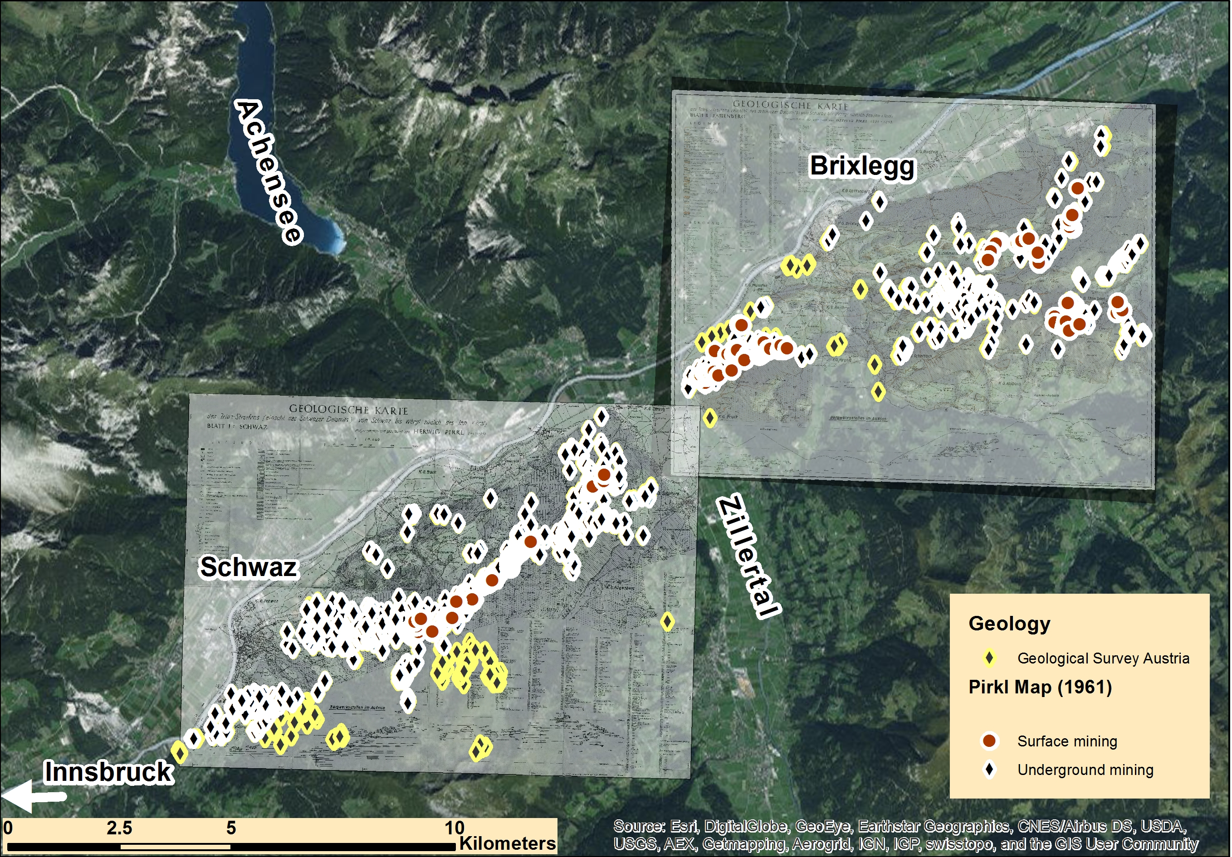
Alpine Copper II, Innsbruck, 21. – 23.09.2016
Information Sources: Geology
Notes:
The next 15 minutes we are going to deal with “Titel”. Unfortunately one of the co-authors, Joachim Lutz can‘t be here today – I will try to answer your questions with all the tools he tought me until now.

Slide 5
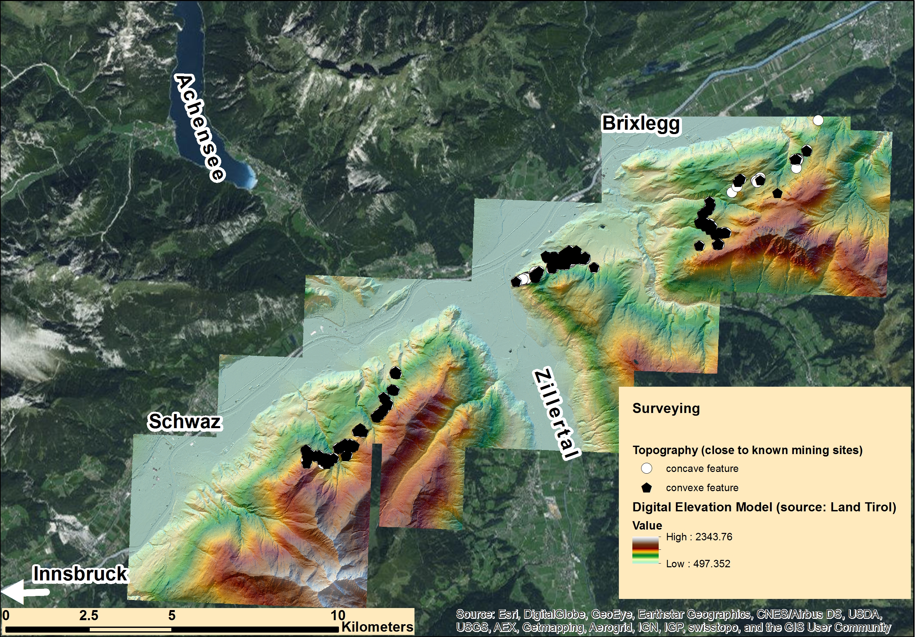
Alpine Copper II, Innsbruck, 21. – 23.09.2016
Surveying: Digital Elevation Model
Notes:
The next 15 minutes we are going to deal with “Titel”. Unfortunately one of the co-authors, Joachim Lutz can‘t be here today – I will try to answer your questions with all the tools he tought me until now.

Slide 6
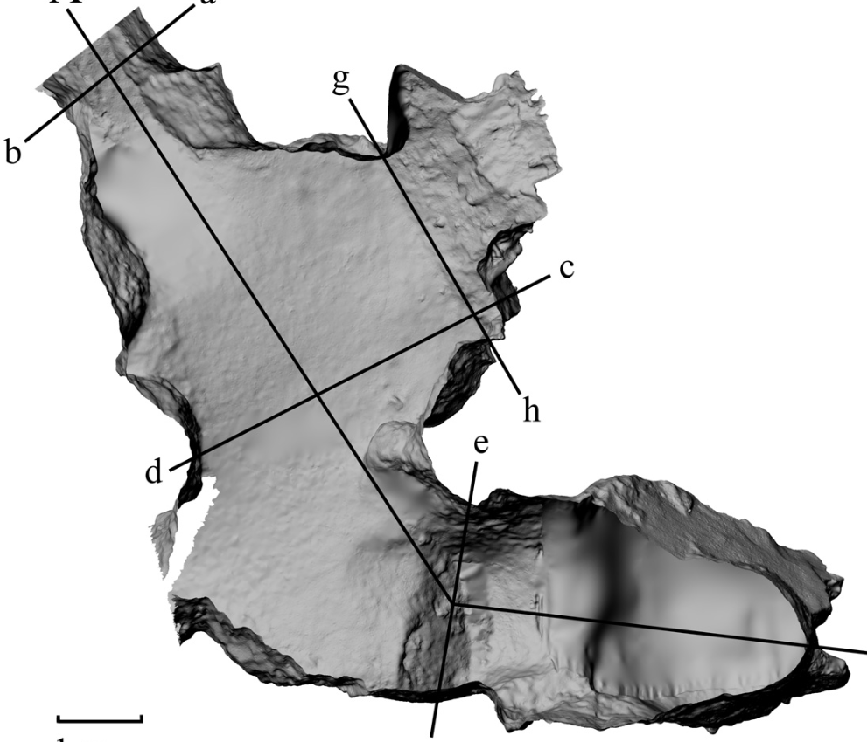
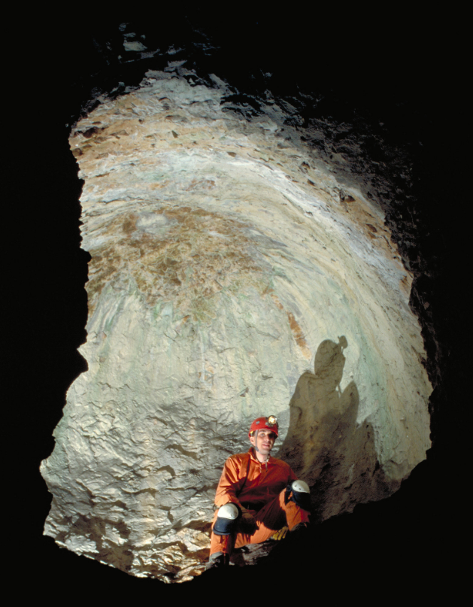
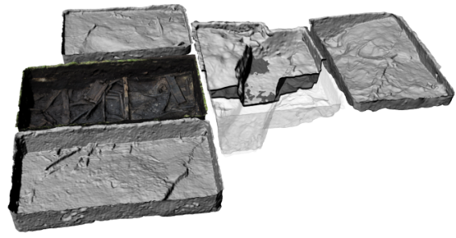
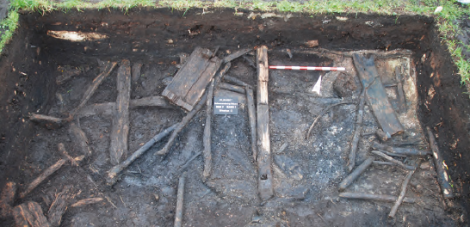
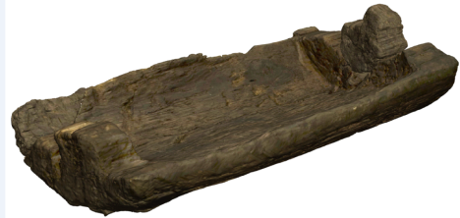
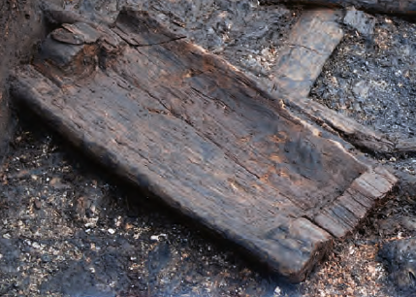
Alpine Copper II, Innsbruck, 21. – 23.09.2016
Surveying: 3D models
Spacetime Volume
Phenomenal Places
Physical Things
Digital Measurement Event
Digital Object
  Software Execution
  Software Execution
  Software Execution
Digital Object
Digital Objects
3D models
Declarative Places
Notes:
The next 15 minutes we are going to deal with “Titel”. Unfortunately one of the co-authors, Joachim Lutz can‘t be here today – I will try to answer your questions with all the tools he tought me until now.

Slide 7
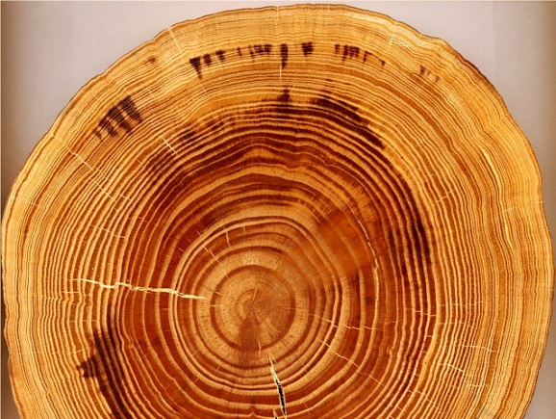
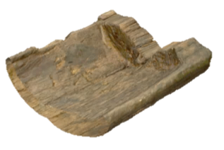

s
Alpine Copper II, Innsbruck, 21. – 23.09.2016
Dendrochronology: Tree Ring Analysis
Design or Procedure
Observation
Sample Taking
removed
Tree ring reference sequence
consists of
Sample
used technique
Sbm 5
sampled from
Inference Making
Dating
Physical Object
assigned dimension
Wooden trough
used
Declarative Time Span
Phenomenal Time Span
has time span
Benefication Activity
approximates
TPQ 892BC

Slide 8
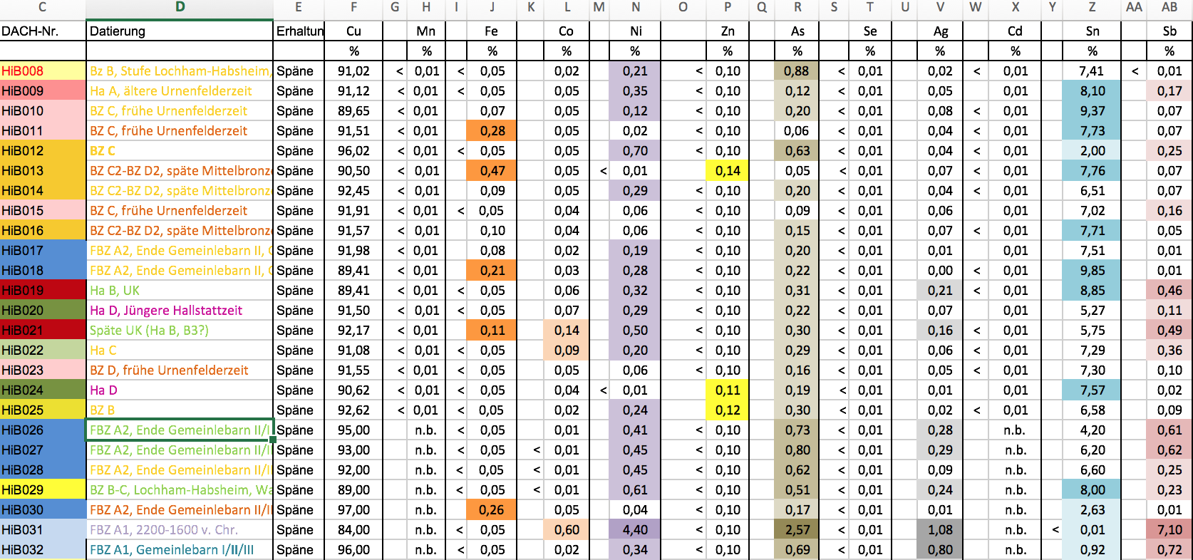
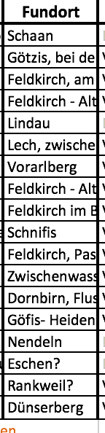
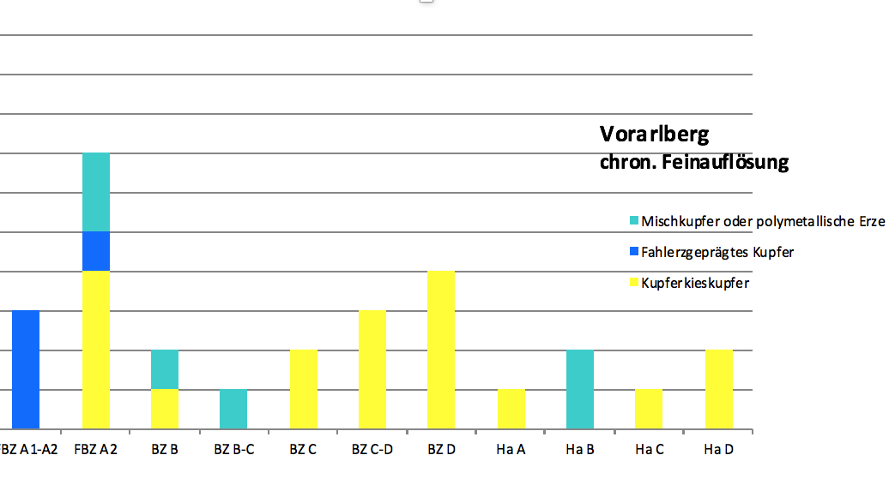
Alpine Copper II, Innsbruck, 21. – 23.09.2016
Metallurgy: Geochemical Analysis
Source: Caroline Grutsch
Notes:
The next 15 minutes we are going to deal with “Titel”. Unfortunately one of the co-authors, Joachim Lutz can‘t be here today – I will try to answer your questions with all the tools he tought me until now.

Slide 9
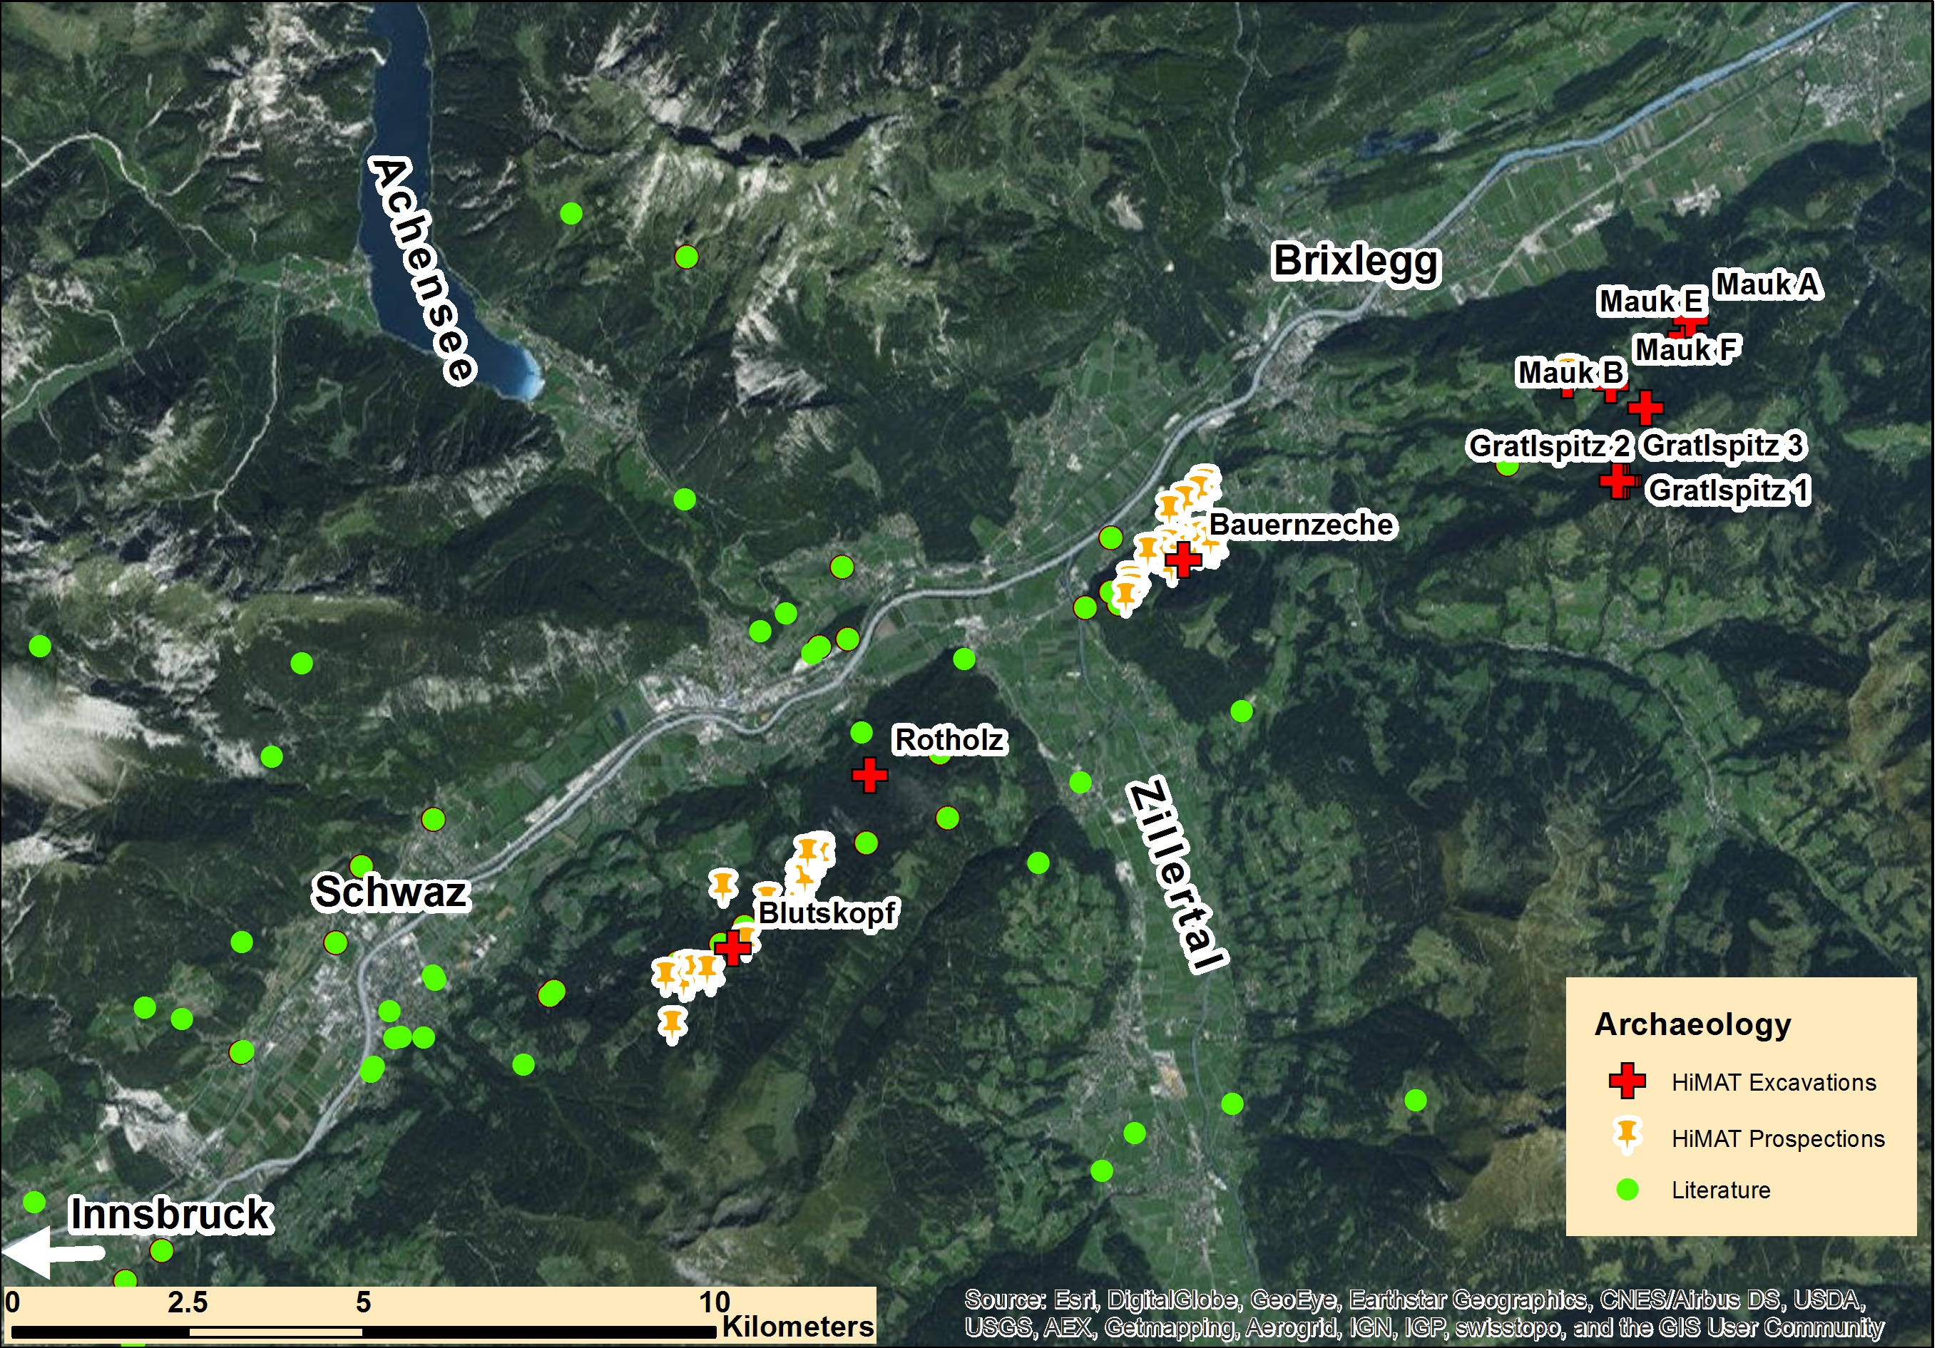
Alpine Copper II, Innsbruck, 21. – 23.09.2016
Archaeology
Notes:
The next 15 minutes we are going to deal with “Titel”. Unfortunately one of the co-authors, Joachim Lutz can‘t be here today – I will try to answer your questions with all the tools he tought me until now.

Slide 10
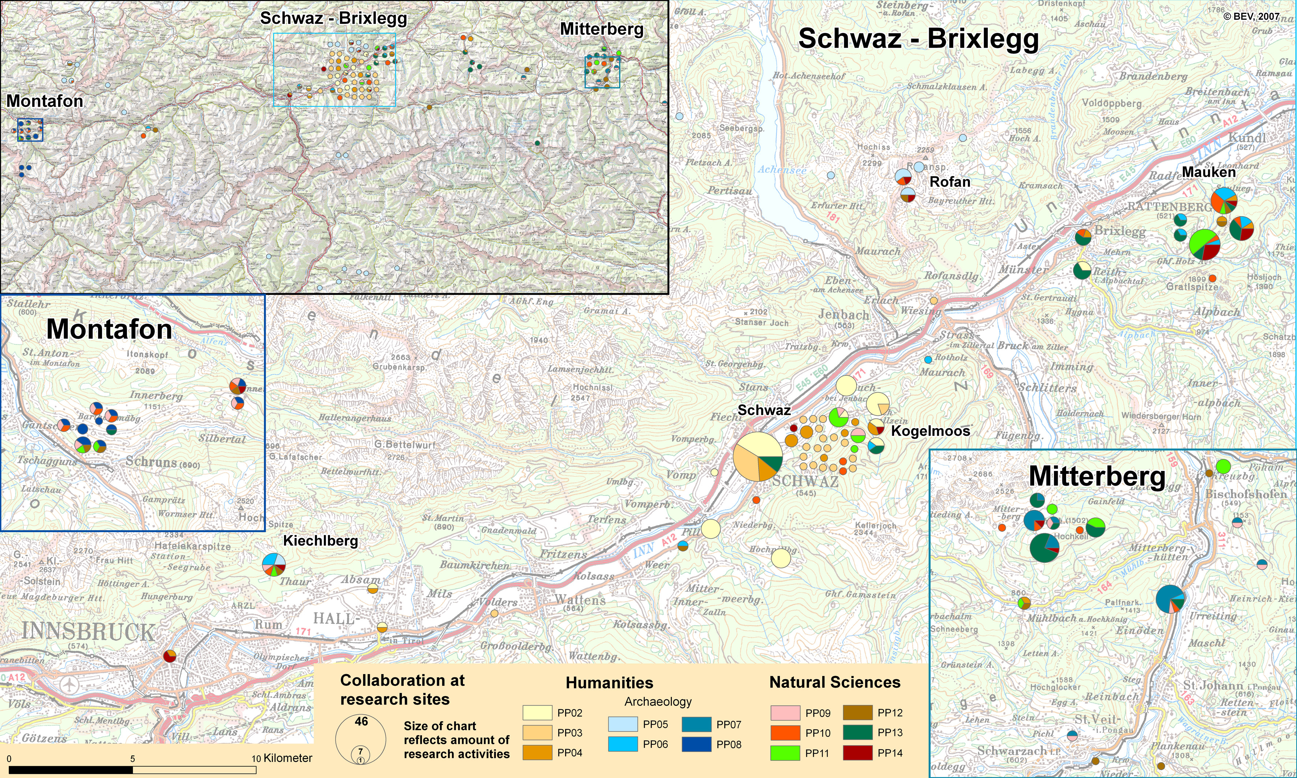
Alpine Copper II, Innsbruck, 21. – 23.09.2016
Database for Mining Research
Notes:
The next 15 minutes we are going to deal with “Titel”. Unfortunately one of the co-authors, Joachim Lutz can‘t be here today – I will try to answer your questions with all the tools he tought me until now.

Slide 11
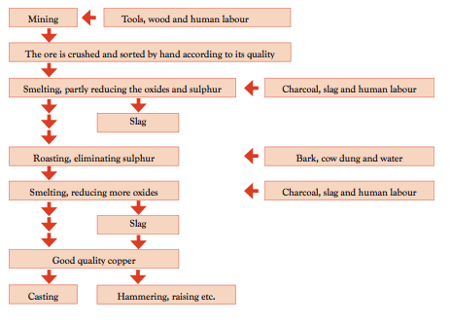
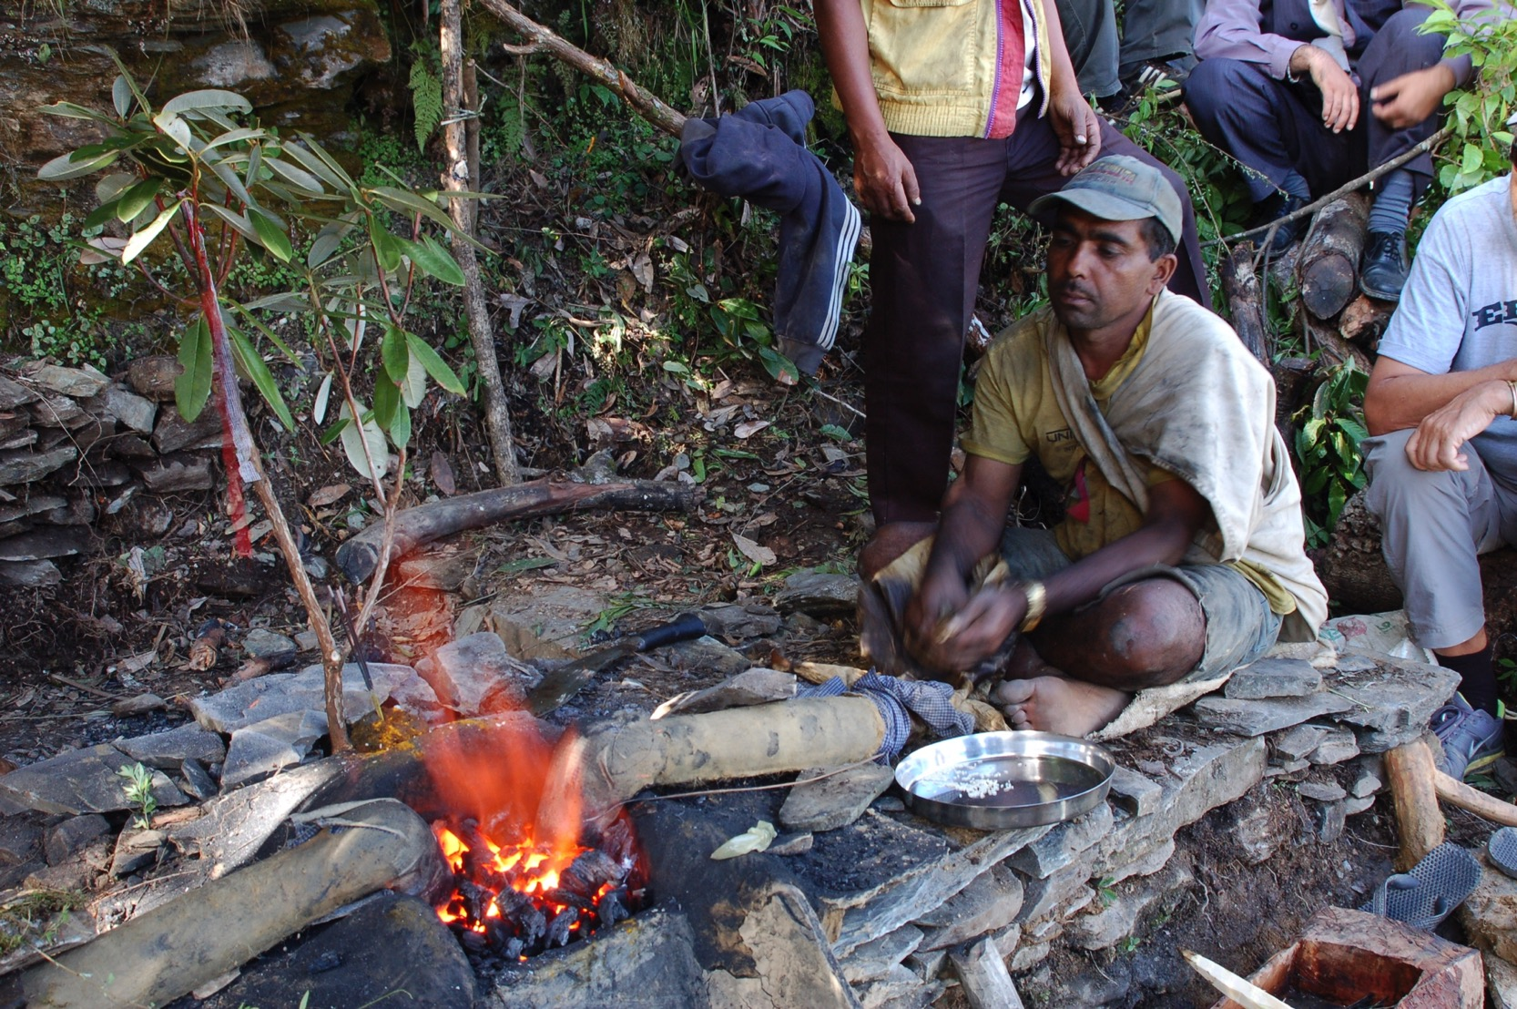
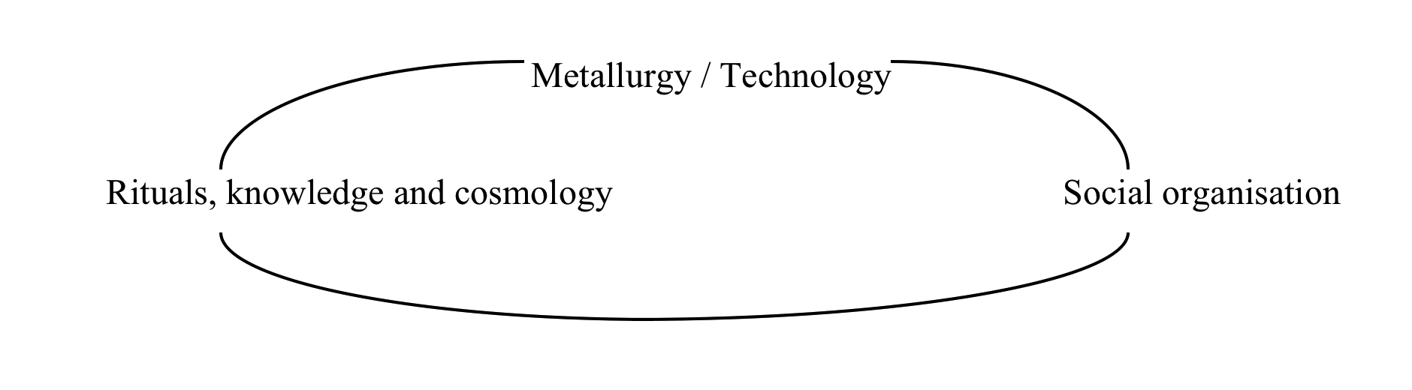
Alpine Copper II, Innsbruck, 21. – 23.09.2016
Ethnoarchaeology
THE NEPAL-PROCESS OF COPPER SMELTING
Source: Nils Anfinset
Notes:
The next 15 minutes we are going to deal with “Titel”. Unfortunately one of the co-authors, Joachim Lutz can‘t be here today – I will try to answer your questions with all the tools he tought me until now.

Slide 12
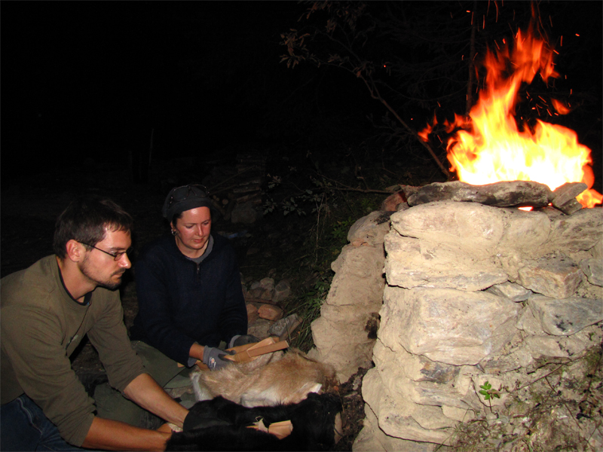
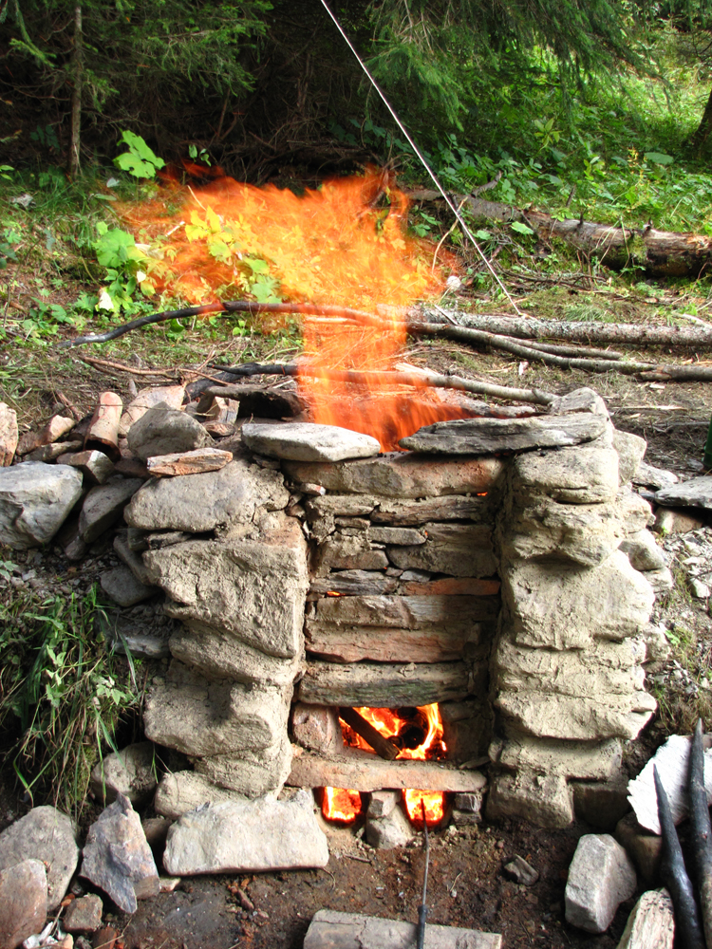
Alpine Copper II, Innsbruck, 21. – 23.09.2016
Experimental Archaeology
Source: Erica Hanning
Notes:
The next 15 minutes we are going to deal with “Titel”. Unfortunately one of the co-authors, Joachim Lutz can‘t be here today – I will try to answer your questions with all the tools he tought me until now.

Slide 13
Alpine Copper II, Innsbruck, 21. – 23.09.2016
Integration model – 6 categories
Research activities
(CRMscience, CRMinf, CRMgeo)
Research objects (CRM)
Observations
Human activities
(past and present)
Physical Things
Interpretations
Measurements (Archaeometry)
Technology
Dokumentation
Notes:
The next 15 minutes we are going to deal with “Titel”. Unfortunately one of the co-authors, Joachim Lutz can‘t be here today – I will try to answer your questions with all the tools he tought me until now.

Slide 14
Alpine Copper II, Innsbruck, 21. – 23.09.2016
Practical Integration
Define terms for 6 categories that are relevant for the research questions
Data collection
  Transformation and mapping of existing data to our 6 categories with their specialisation terms and creation of relations
  excel sheet to enter categories, terms and relations
3. Co-reference: identification of the same physical objects (activities, technologies) in different sources
4. Conversion of data in a data format that can represent networks (e.g. RDF)
5. Query the network to answer research questions
6. Visualisation of query results in GIS or Diagramms
Notes:
The next 15 minutes we are going to deal with “Titel”. Unfortunately one of the co-authors, Joachim Lutz can‘t be here today – I will try to answer your questions with all the tools he tought me until now.

Slide 15
Alpine Copper II, Innsbruck, 21. – 23.09.2016
1a. Relevant terms - Research objects –
Human activity
Physical Things
Extraction
Technology
Topographic structures
Chaine operatoire
Smelting
Material
Extraction
Benefication
concave
convex
CuFeS2
Benefication
Smelting
fire setting
washing
crushing
Chaine operatoire
Experiments
Extraction
Benefication
Smelting
Furnace
Roasting bed
Notes:
The next 15 minutes we are going to deal with “Titel”. Unfortunately one of the co-authors, Joachim Lutz can‘t be here today – I will try to answer your questions with all the tools he tought me until now.

Slide 16
Alpine Copper II, Innsbruck, 21. – 23.09.2016
1b. Relevant terms - Research activities
Observations
Measurements (Archaeometry)
Periods
Interpretations
Geochemical analysis
Surveying
Dendrochronological analysis
fire setting
Geological survey
Archaeology
Ethnological studies
Grouping of ores/products
Functional assignments
Prospection
Excavation
Technological assignments
Bronze Age
Iron Age
Dokumentation
Notes:
The next 15 minutes we are going to deal with “Titel”. Unfortunately one of the co-authors, Joachim Lutz can‘t be here today – I will try to answer your questions with all the tools he tought me until now.

Slide 17
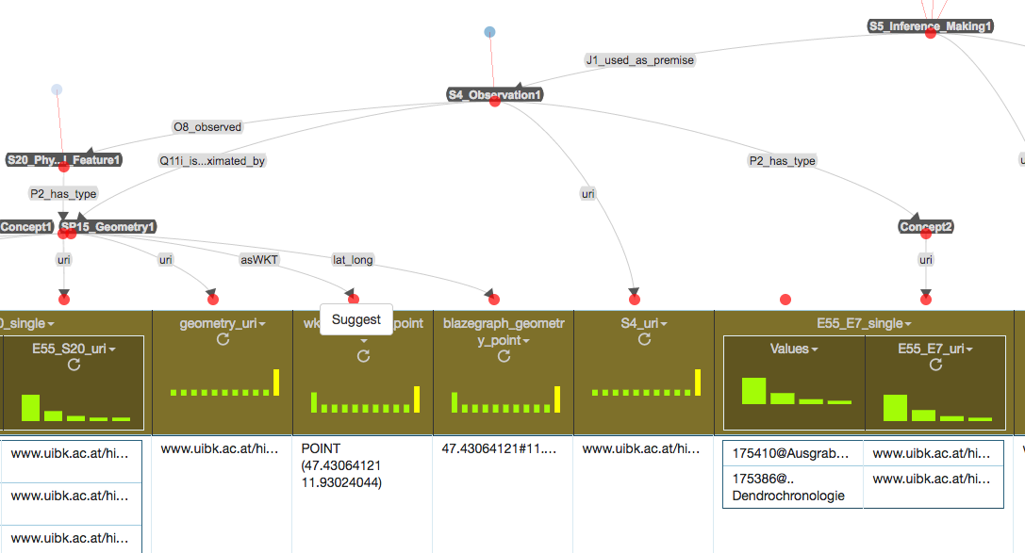
Alpine Copper II, Innsbruck, 21. – 23.09.2016
2. Data collection
  Transformation and mapping of existing data to our 6 categories with their specialisation terms and creation of relations – Karma tool
  Excel sheet to enter categories, terms and relations
Notes:
The next 15 minutes we are going to deal with “Titel”. Unfortunately one of the co-authors, Joachim Lutz can‘t be here today – I will try to answer your questions with all the tools he tought me until now.

Slide 18
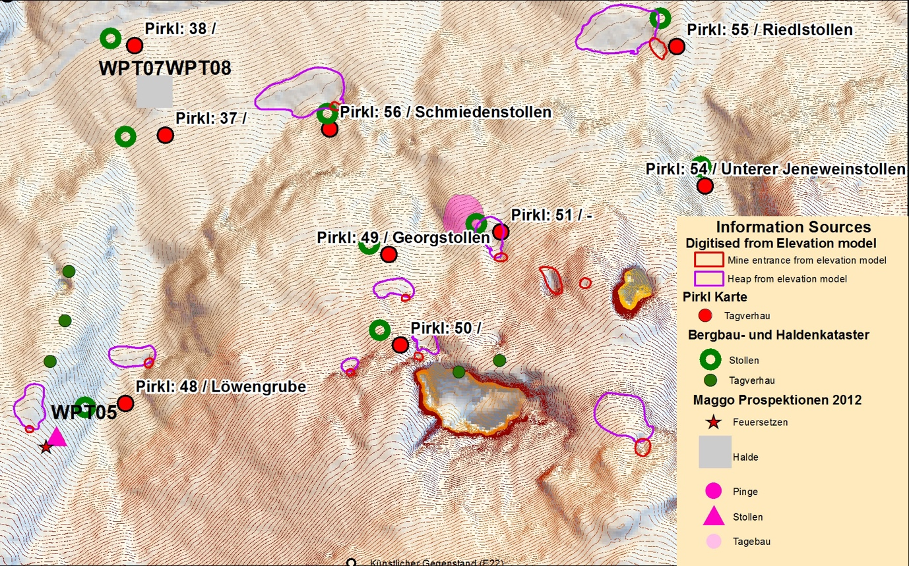
Alpine Copper II, Innsbruck, 21. – 23.09.2016
3. Co-reference
Identification of the same physical objects in different sources
e.g. Distance analysis in Geoinformation system – integrate results in semantic representation
Digital Elev. Mod.
Pirkl Map 1961
Geol. Survey Austria
HiMAT Prospection
Notes:
The next 15 minutes we are going to deal with “Titel”. Unfortunately one of the co-authors, Joachim Lutz can‘t be here today – I will try to answer your questions with all the tools he tought me until now.

Slide 19
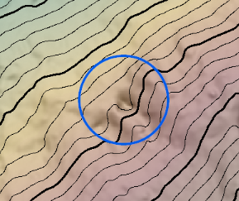
Alpine Copper II, Innsbruck, 21. – 23.09.2016
4.Network representation – Mauk E
Research objects
Research activities
Physical Things
Mauk E (mine)
-Wood sample
Observations
Mauk E Excavation
Past Human activity
Ore extraction (ca. 707 – 720 BC)
Interpretations
Mining from 707-720
Fire setting technology used
Measurements
Dendrochronology
Surveying
Technology
Fire setting
Dokumentation
Notes:
The next 15 minutes we are going to deal with “Titel”. Unfortunately one of the co-authors, Joachim Lutz can‘t be here today – I will try to answer your questions with all the tools he tought me until now.

Slide 20
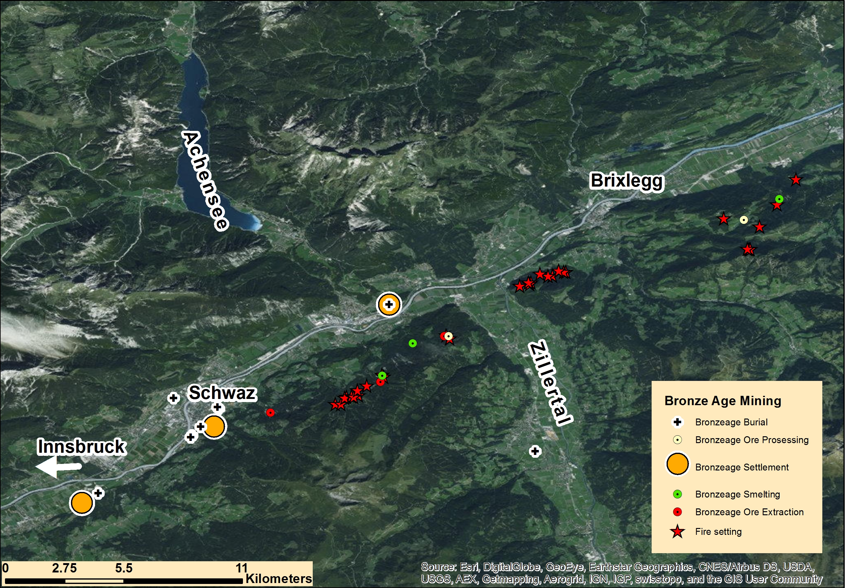
Alpine Copper II, Innsbruck, 21. – 23.09.2016
5. Query the network & 6. Visualisation
Where are mining, settlement and burial sites in the Bronze Age
Notes:
The next 15 minutes we are going to deal with “Titel”. Unfortunately one of the co-authors, Joachim Lutz can‘t be here today – I will try to answer your questions with all the tools he tought me until now.

Slide 21
Alpine Copper II, Innsbruck, 21. – 23.09.2016
Further Queries
How are these physical things dated?
  Goal: an animation showing the dating of physical things of a specific type (e.g. indicating a technology) over time
What is the geochemical signature of samples and artefacts?
  Goal: a creation of types of geochemical signatures and assignments to physical things -> a map of the distribution of geochemical signatures
Where do I find topographic structures relevant for prehistoric mining/metallurgy?
  Goal: a map of potential topographic structures related to prehistoric mining/metallurgy
Which observations/archaeometric analysis/interpretations have been conducted on physical things?
Goal: a list of observations/archaeometric analysis/interpretations that relate to a physical thing
What can I learn from experimental Archaeology and Ethnoarchaeology about technology and types of artefacts/structures used with these technologies?
Goal: a relation of experimental Archaeology and Ethnoarchaeology documentation to prehistoric physical things over the assigned types and assigned technologies
Notes:
The next 15 minutes we are going to deal with “Titel”. Unfortunately one of the co-authors, Joachim Lutz can‘t be here today – I will try to answer your questions with all the tools he tought me until now.

Slide 22
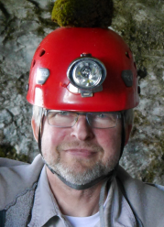
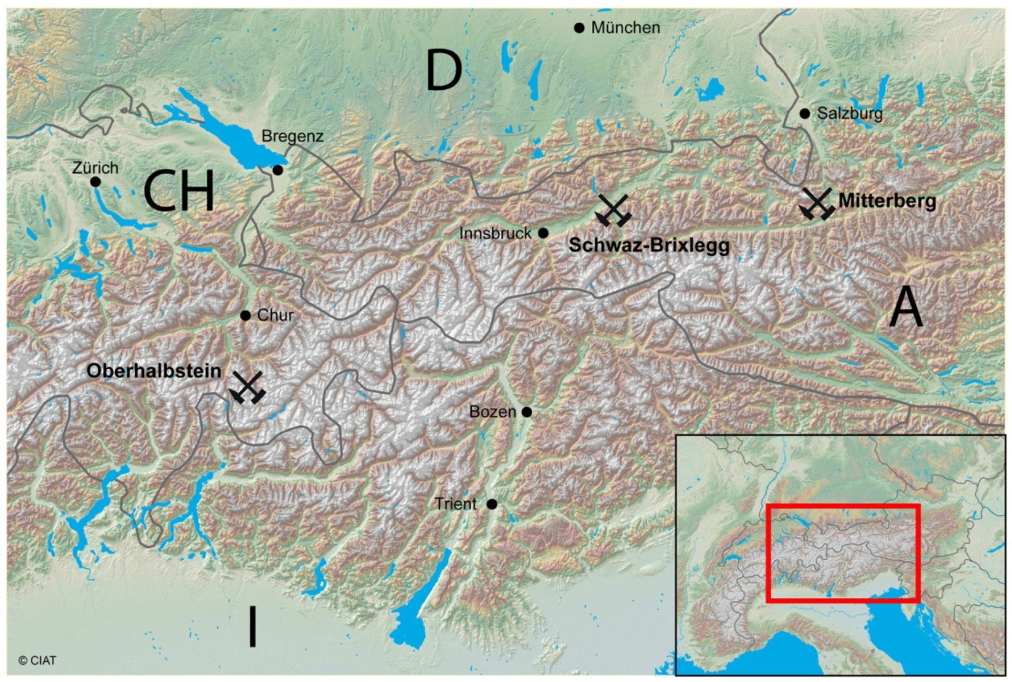
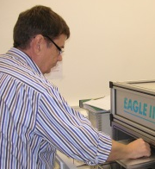
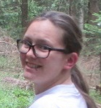
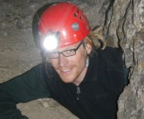
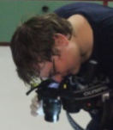
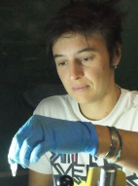
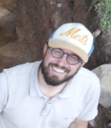
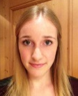



DACH-Project (April 2015 – March 2018):
Prehistoric Copper Production in the Eastern and Central Alps
Mannheim
D University of Bochum, DBM Bochum
CEC Archaeometry Mannheim
A University of Innsbruck (RC HiMAT)
CH University of Zürich
Archäologischer Dienst Graubünden
Graph: G.Goldenberg with supplements
Tirol
Mitterberg
Oberhalbstein
Notes:
This thesis will also be written in the frame of the DACH-project within the Research Centre HiMAT – which I have to thank for Gert Goldenberg, who is of course leading the project.

