Slide 1
CIDOC CRM in the context of the German National Research Data Infrastructure (NFDI)
Activities of the German National Museum Nuremberg
Notes:
Hello, my name is Robert Nasarek and I‘m working at the German National Museum in Nuremberg. Today I want do give a update about our activities, especially in the context of the German National Research Data Infrastructure in short NFDI, because standards will play a big role in it.

Slide 2
Content
Erlangen CRM
WissKI
National Research Data Infrastructure (NFDI)
NFDI4Culture
NFDI4Memory/ NFDI4Objects
Notes:
So, I will give an update about our OWL Implementation of CIDOC CRM, WissKI as a virtual research environment which uses CIDOC CRM as the preferred Graph Data Model and then focus on our actuations inside the National Research Data Infrastructure (NFDI).

Slide 3




Erlangen CRM
http://erlangen-crm.org/
ECRM => CIDOC-CRM 7.1.1 | current: 7.2
EFRBRoo/LRMoo=> FRBRoo 1.0.2 | current: 3.0
ECRMGeo=> CRMGeo v1.4 | current online 1.2
Notes:
On erlangen-crm.org we provide owl implementations of CIDOC CRM, FRBRoo and CRMgeo. You may wonder, that we provide an CRMGeo v.1.4 while the current online version is 1.2. That’s because the contributers had access to a more recent version, which is not available online.

Slide 4


WissKI
http://wiss-ki.eu/
WissKI 3.0 release
Website renewal and documentation update
Notes:
WissKI is a virtual research environment and content management system for research data based on Drupal. It connects an ontology driven triple store with Drupal content logic to create and manage linked open data. Soon version 3 will be released, which will enable the possibility to send and process federated queries to different data sources.
We are also renewing our web presence and our Documentation, so soon there will be new code and new colors. So much for that, let's get to the main topic: NFDI.

Slide 5






NFDI
Data Management
Network
Storage / Accessibility
Promote Solutions (not Servers)
Federation
Notes:
Since July 2021, the Germanisches Nationalmuseum has been a participant in the newly founded consortium NFDI4Culture within the National Research Data Infrastructure. That's also why I'm giving you the update, because my job is partly paid by Consortium funds.
Why is the NFDI interesting for the CIDOC SIG MEETING?
The purpose of the National Research Data Infrastructure ist to
manage scientific and research data
provide long-term data storage, backup and accessibility
federate the research data
network the data both nationally and internationally
make data FAIR
mainly funds and supports immaterial (standards, skills, networks) not physical (servers, storage) things.
So as you can see the NFDI is a wonderful place for a standard like CIDOC CRM and all contributing or consulting institutions - not only the German National Museum - can promote preferred Methods, Software or Standards like the CRM within its structures.
How does it work?

Slide 6
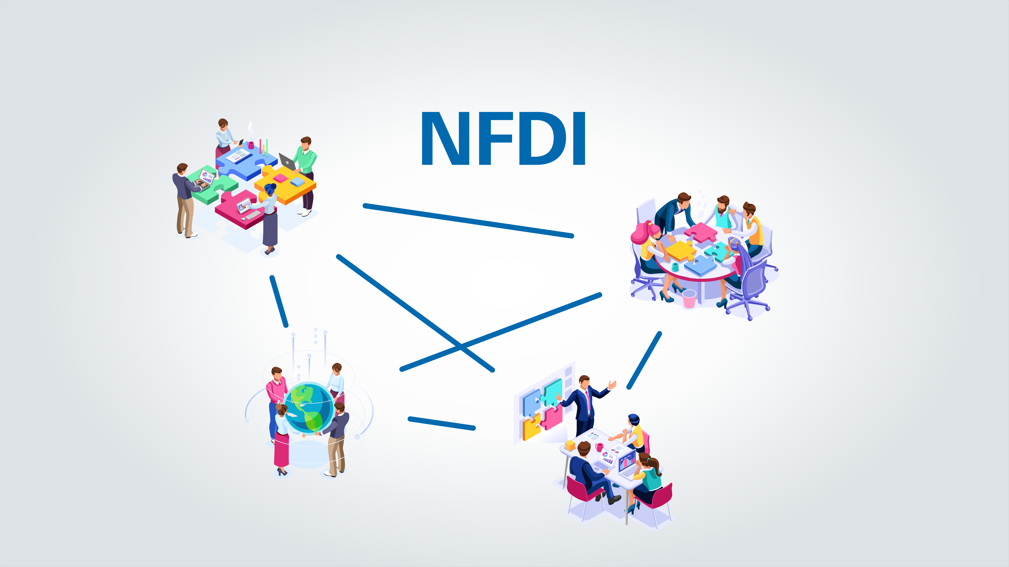




NFDI
Long term cooperation
CONSORTIA
CONSORTIA
ASSEMBLY
Focus on community needs
Uses existing structures
SCIENTIFIC
SENATE
DIRECTORATE
Cross sectoral
Notes:
The NFDI is organized through four structures:
0. Consortia (which are build around scientific fields or methods)
The Consortia Assembly
The Directorate
And the Scientific Senate
The most important structure for us are the consortia. Their purpose is to
Establish a long term cooperation between users and providers (public founded organizations, i.e. universities, research institutes)
focus on community needs
uses existing structures
tackle cross-consortia and foster cross-sectoral research

Slide 7
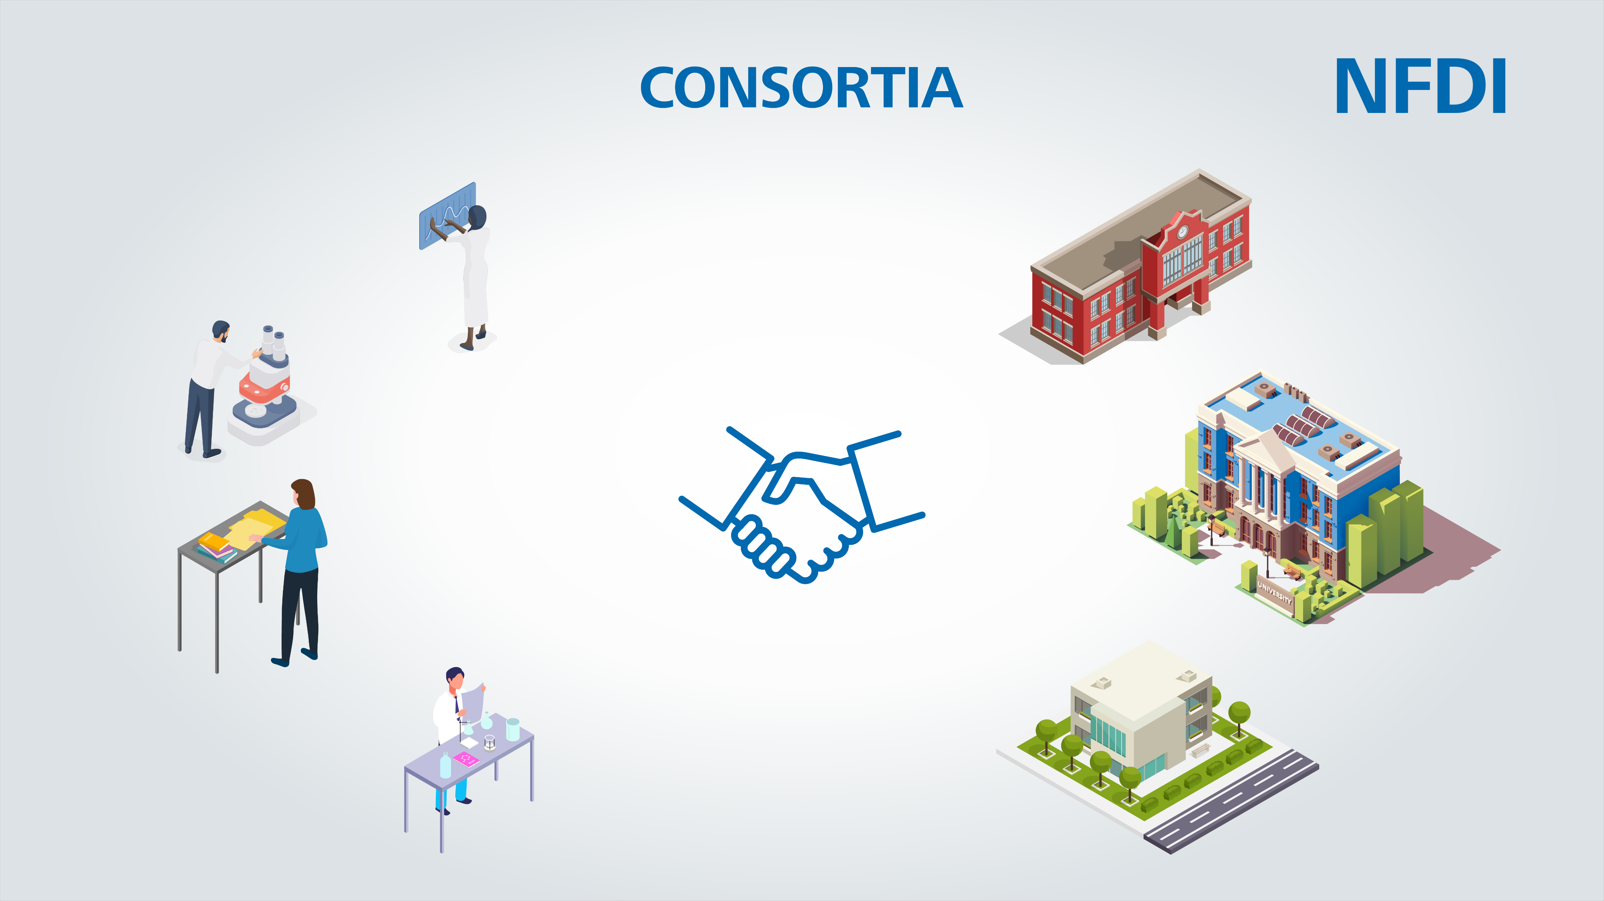
NFDI
Long term cooperation
Participants
Focus on community needs
Applicant Institution
Spokesperson
Uses existing structures
Community
Co-Spokespersons
Cross sectoral
Co-applicant Institutions
Notes:
Every Consortia has an
applicant Institution who provides the spokesperson
multiple co-applicants, each of which provides co-spokespersons: They “decide” on things or are responsibly to fulfill predefined goals.
Participants, which can be institutions or normal persons and which are funded for specials tasks and
Link to the scientific community for backlinks and advices, but which receives no other monetary support.

Slide 8
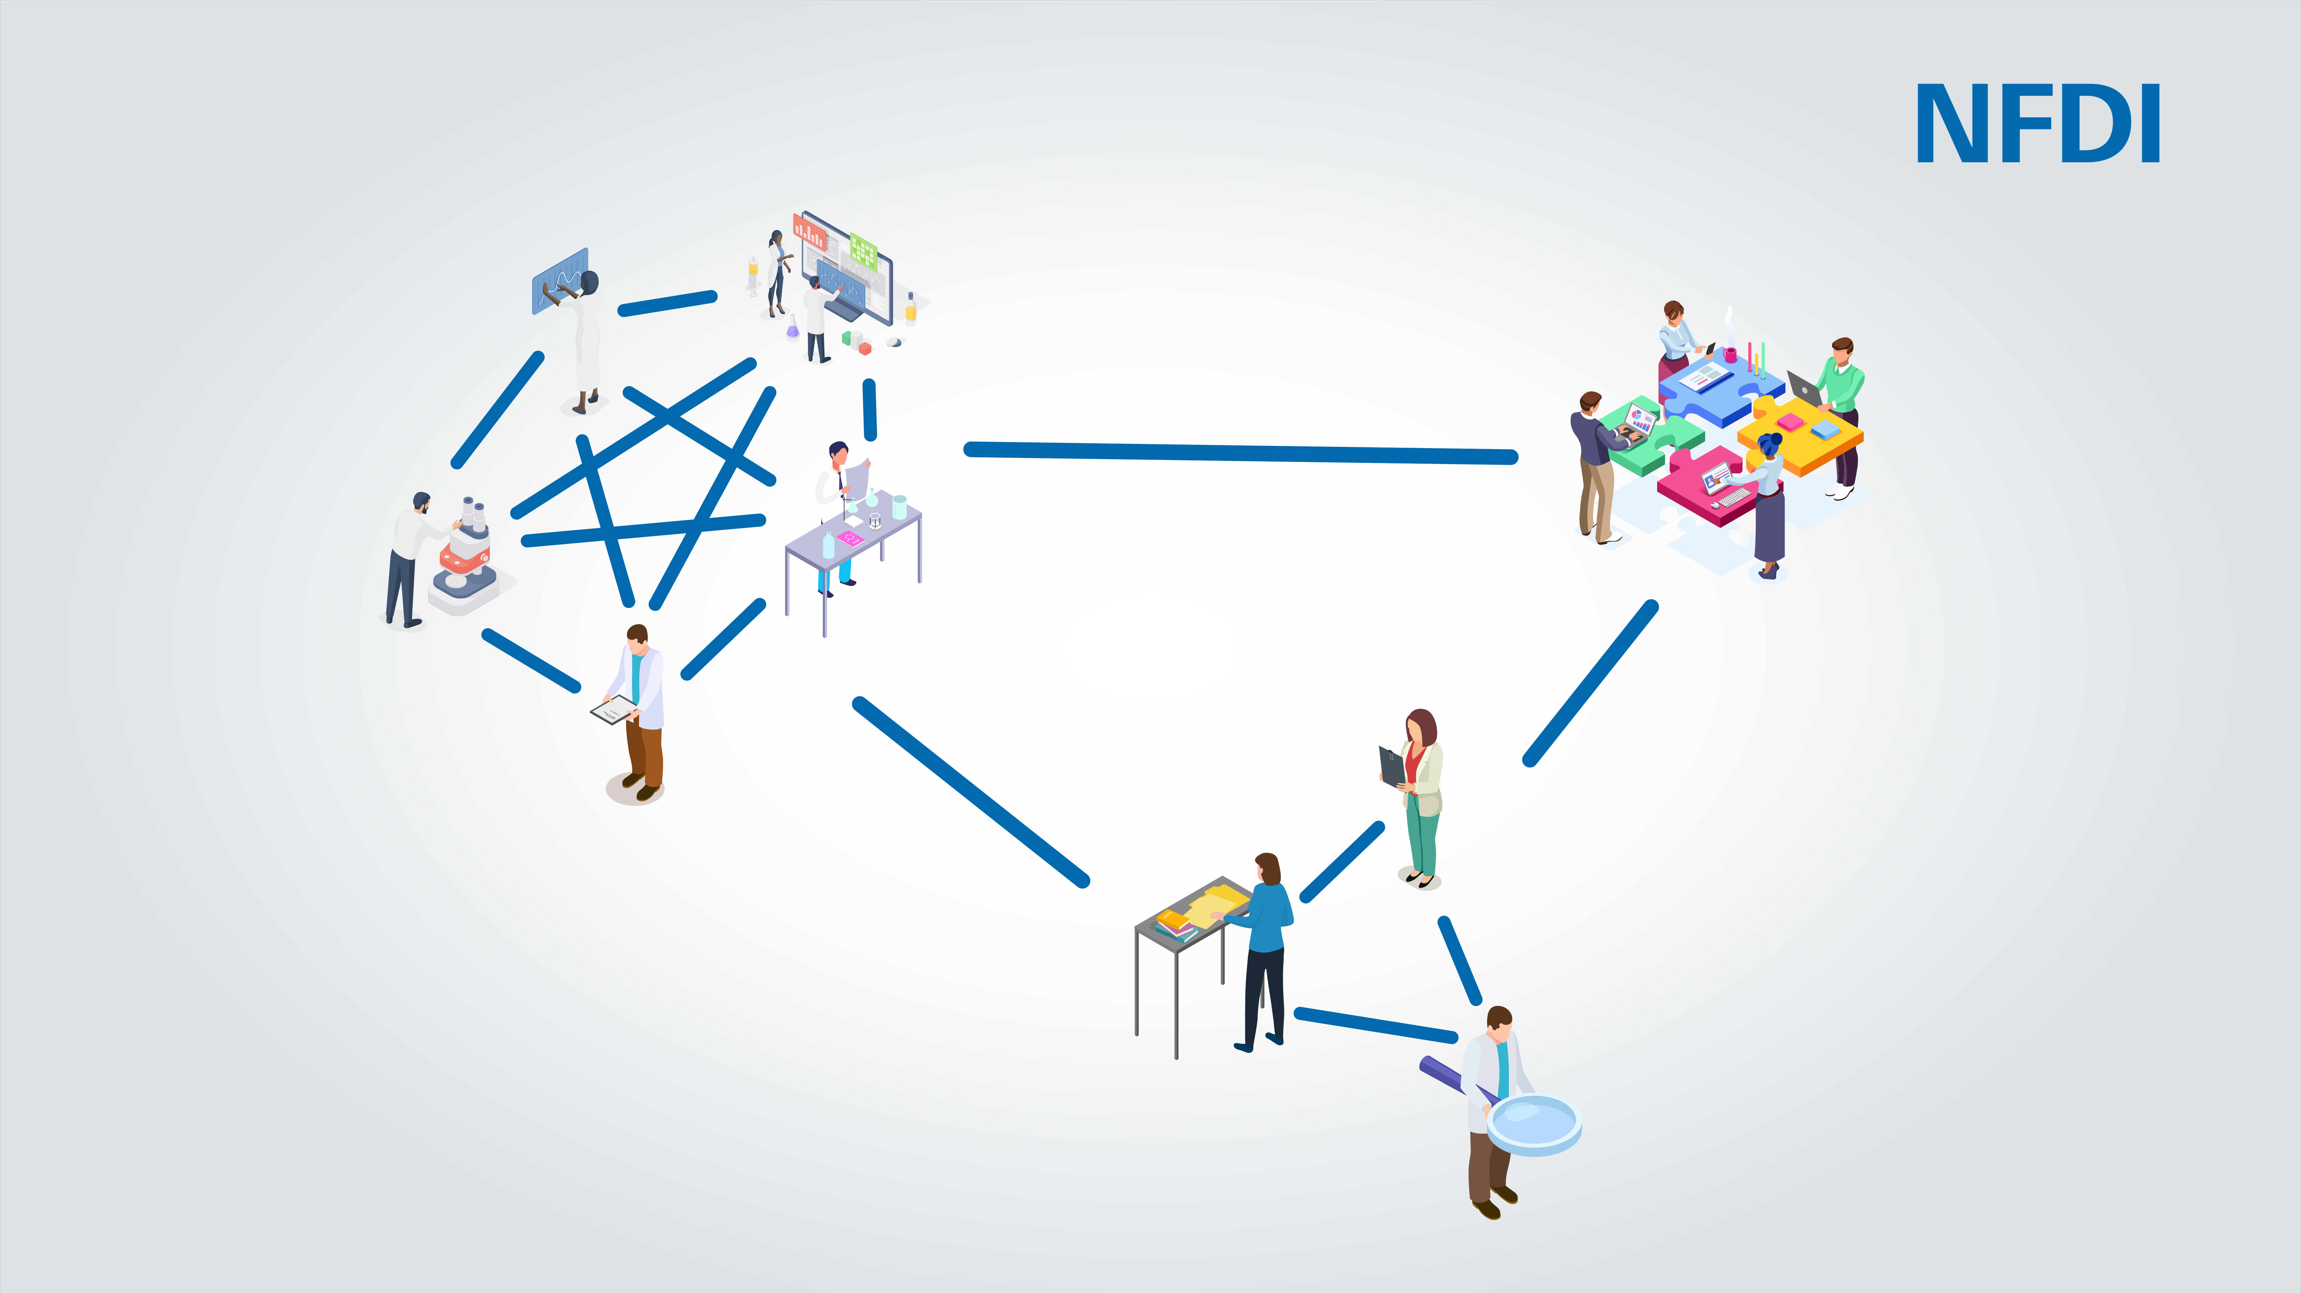


NFDI
4Culture
Infrastructure for architecture, art history, musicology, theatre, dance, film, media studies, galleries, libraries, archives, museums
Formally organized and service orienta-ted task areas
Task Areas
Data Publication and Data Availability
Data Capture and Enrichment
Working Groups
Working Groups operating across task areas
LOD: Knowledge Graph
Data Standards, Quality and Curation
Contact for support and consulting
Support
Helpdesk
Notes:
All Consortia uses three tools to fulfill their purposes:
formally organized and service-oriented task areas.
Working Groups operating across task areas and
Providing support and consulting
As mentioned, the Germanisches Nationalmuseum is a participant in the NFDI4Culture consortium. This consortium aims to strengthen and develop infrastructures in the fields of architecture, art history, musicology, theater, dance, film, media studies, galleries, libraries, archives and museums.
The German National Museum is part of three task areas: Data Capture and Enrichment, Data Publication and Data Availability and Data Standards, Quality and Curation.
It‘s part of the Working Group about the Knowledge Graph, which should unite as much data as possible and
it is the point of contact for specific questions or more in-depth advice at the Helpdesk of NFDI4Culture
In all these fields the GNM has a clear position: The CIDOC CRM is the lingua franca between the different data storages. The CRM allows to model both process- and object-oriented domains of different scientific fields. It has with the Erlangen CRM a technical implementation in OWL and can therefore be used in software like WissKI, ResearchSpace, Omeka S or MediaWiki relatively easily.

Slide 9



NFDI
4Culture
Infrastructure for architecture, art history, musicology, theatre, dance, film, media studies, galleries, libraries, archives, museums
Contributing ex-pertise on domain-specific standards
Task Areas
Data Publication and Data Availability
Data Capture and Enrichment
Working Groups
Optional deploy-ment of data for a pilot process
LOD: Knowledge Graph
Data Standards, Quality and Curation
WissKI for publication and storage
Support
Helpdesk
Notes:
Besides this position, GNM also has defined tasks in which CRM plays a role:
0. Contributing expertise on domain-specific standards
Deploying data for a pilot processes if possible and
Continueing the development of WissKI for publication and storage of research data.

Slide 10


NFDI
4Memory
Infrastructure for history and historical methods
Metadata cata-loguing and documentation of research data
Task Areas
Data Connectivity
Working Groups
Interoperable Data Linkage for the Data Space
Harmonization of cataloguing and description systems
Support
Conceptualizing of a 4Memory-Ontology
Notes:
In addition to the already approved consortium NFDI4Culture, the GNM is still a participant in NFDI4Memory and NFDI4Objects, which are in the third and last application phase.
As a participant in NFDI4Memory, we are part of the Task Area Data Connectivity. Inside this structure we are:
working on metadata cataloguing and documentation of research data
helping to provide interoperable data linkage for the data space
trying to harmonize the cataloguing and description of systems
and support the conceptualizing of a 4Memory-Ontology

Slide 11
NFDI
4Objects
Research Data Infrastructure for the Material Remains of Human History
Task Areas
Working Groups
Support
Notes:
The exact tasks within NFDI4Objects have not yet been determined, but will certainly be in the area of standards, Linked Open Data and WissKI.
As you can see, Standards take place in many different NFDI structures and we may can use those evolving network as a new channel to the community, a place to catch suggestions or to collecting use cases or something like that.
So much for the activities of the Germanisches Nationalmuseum in the context of the NFDI, thank you for your attention!
Eigene Fragen: Wie wird anderswo CIDOC CRM technisch umgesetzt? Welche sind alternative Standards? Wo liegen die Vor- und Nachteile?

Slide 12
Contribution
Icons made by Freepik, Monkik, juicy_fish, Good Ware, vectorsmarket15, Becris, Pixel perfect, Nhor Phai, Flat Icons, Darius Dan, Smashicons, Nikita Golubev, Zlatko Najdenovski, from www.flaticon.com
Stock Fotos von https://de.freepik.com/
Unter Nutzung von ActivePresenter

